Slide 1
Španielsko Spain

Slide 2
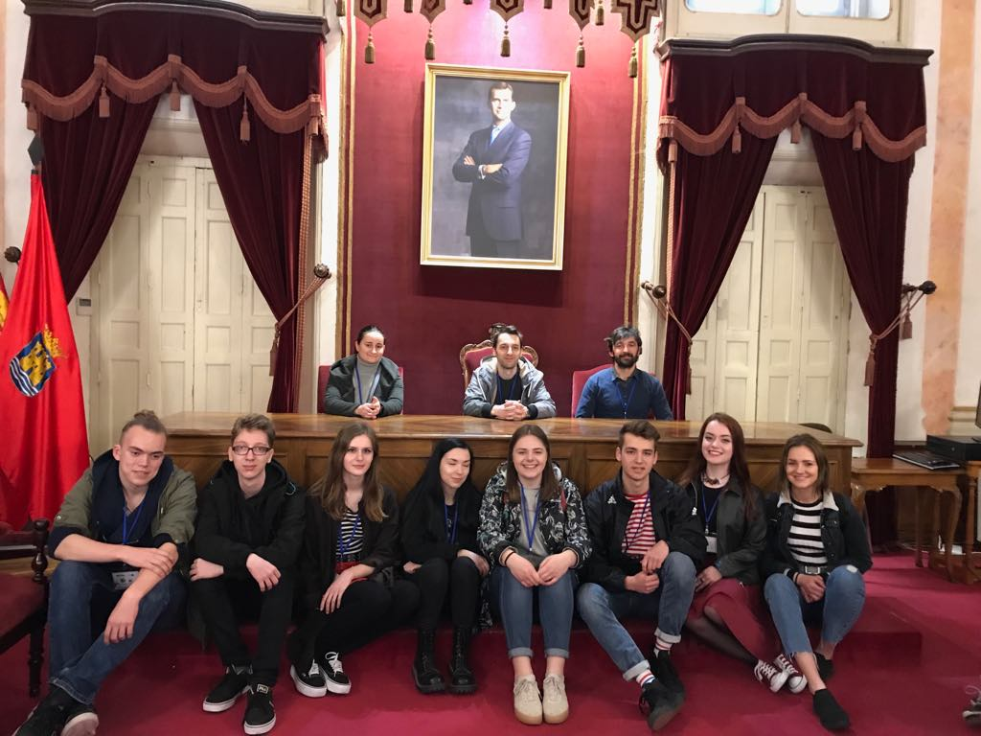
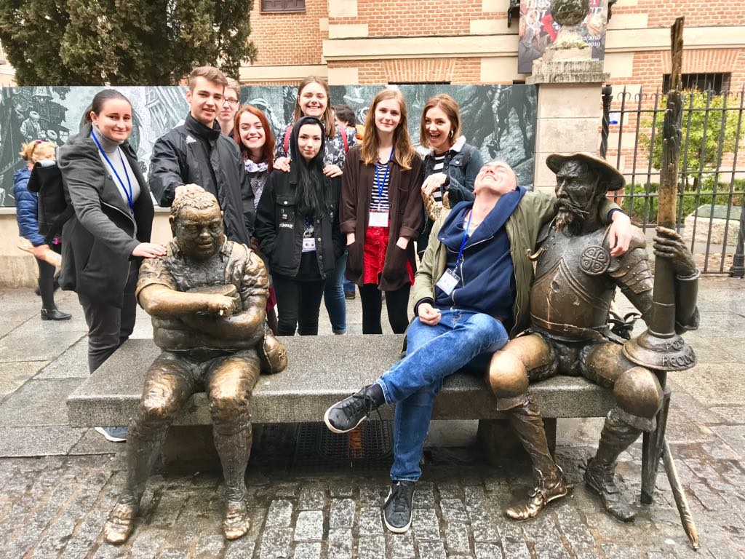
Erasmus
V rámci projektu Erasmus sme mali možnosť navštíviť Španielsko a spoznať tak zvyky, ľudí a kultúru tejto krajiny.
- During the project Erasmus, we had the opportunity to visit Spain and get to know their traditions, people and culture.

Slide 3
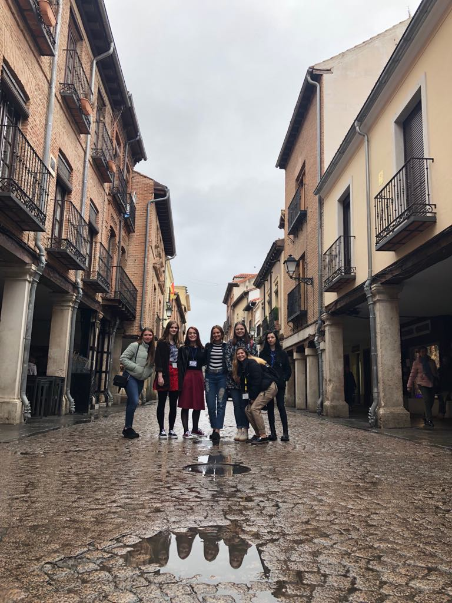
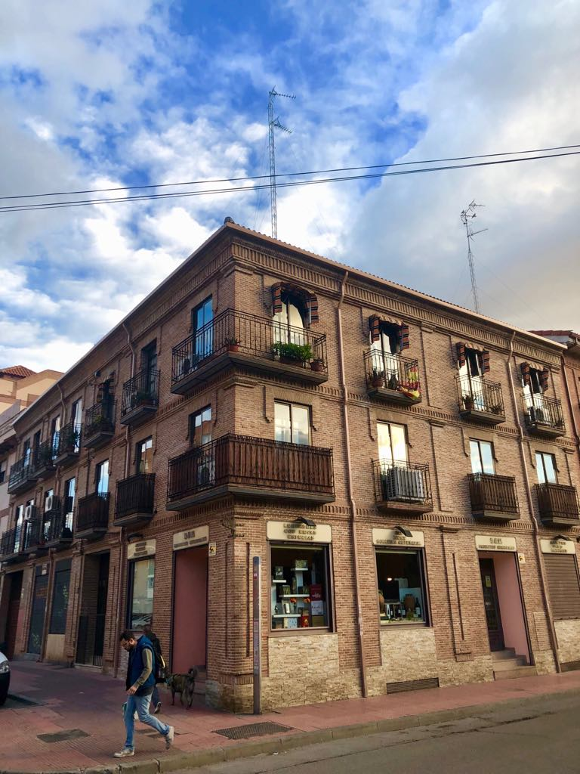
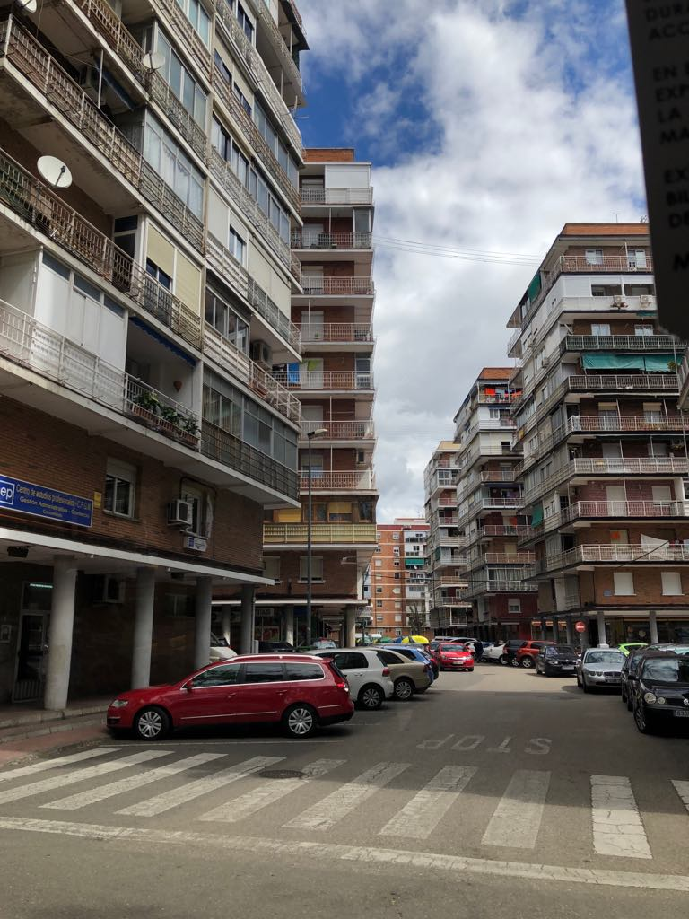
Alcalá de Henares
Mesto, ktoré sme mali možnosť spoznať je preslávené príbehom Dona Quijotta. Veľmi nás zaujala miestna architektúra a pamiatky.
- The city that we had the opportunity to know is famous because of the story of Don Quijotte. We really liked the local architecture and monuments.

Slide 4
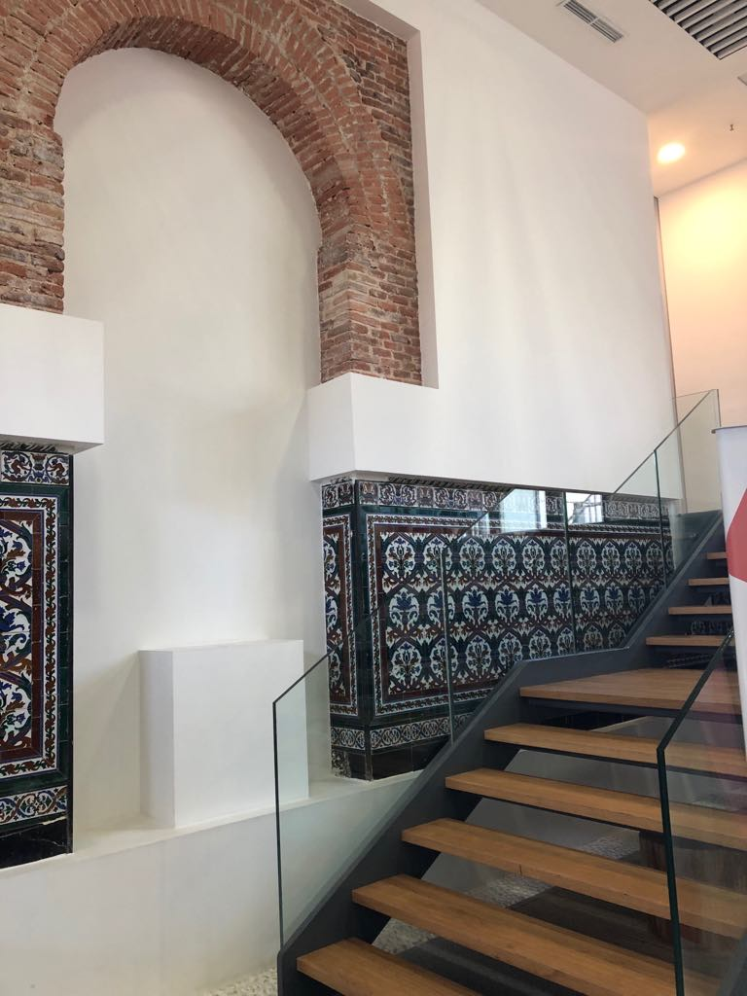
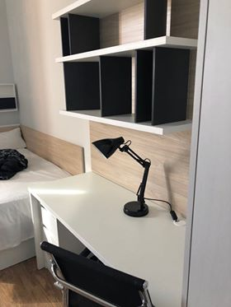
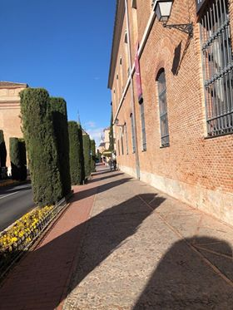
LOPE DE VEGA residencia universitaria
Ubytovnie sa nám veľmi páčilo, cítili sme sa príjemne.
- We liked the student hostel, it was very pretty and we felt good there.

Slide 5
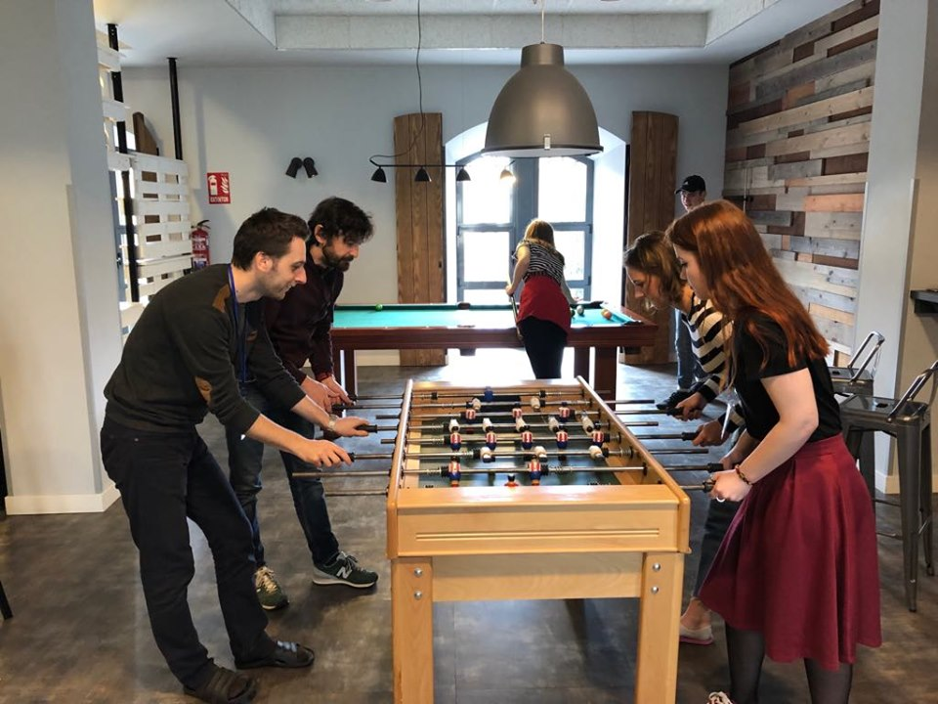
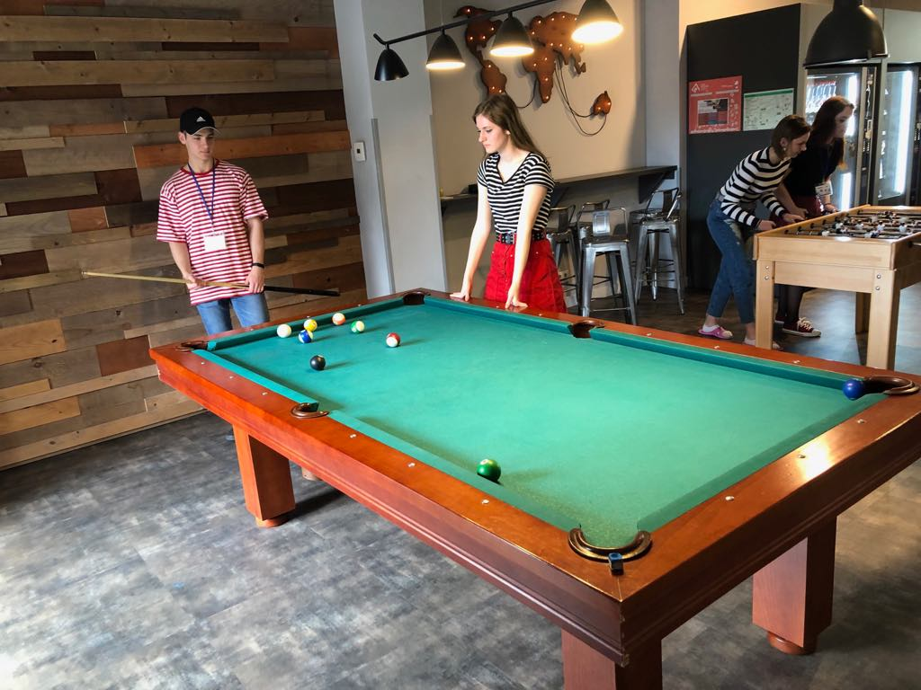
Ako sme trávili voľný čas -How we spent our free time ...
počas voľného času, po rôznych aktivitách, sme boli najčastejšie v spoločenskej miestnosti, kde sme hrali biliard, stolný futbal alebo videohry.
- During our free time, after different activities, we were mostly in the game room, where we played billiard, table football or some videogames.

Slide 6
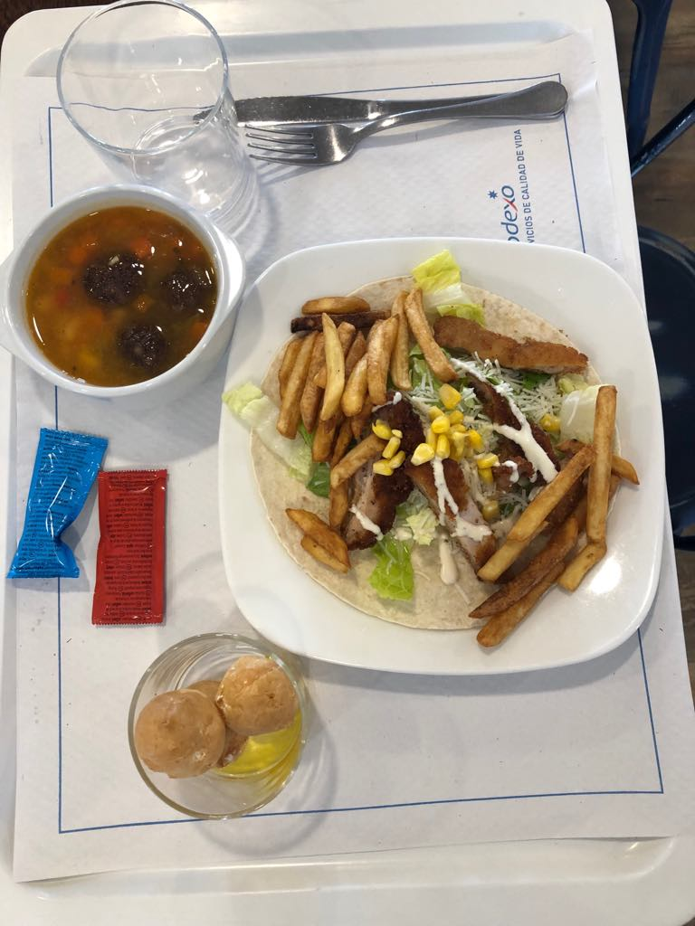
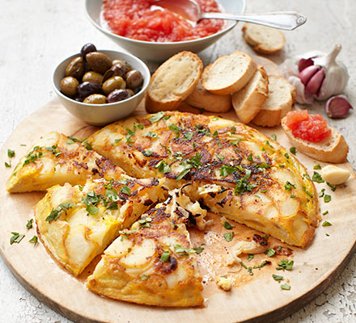
Čo sme jedli? What did we eat?
Ochutnali sme množstvo tradičných jedál ako napríklad tapas, paella, torilla Espanola...
- We tried many traditional foods, like tapas, paella, tortilla Espanola

Slide 7
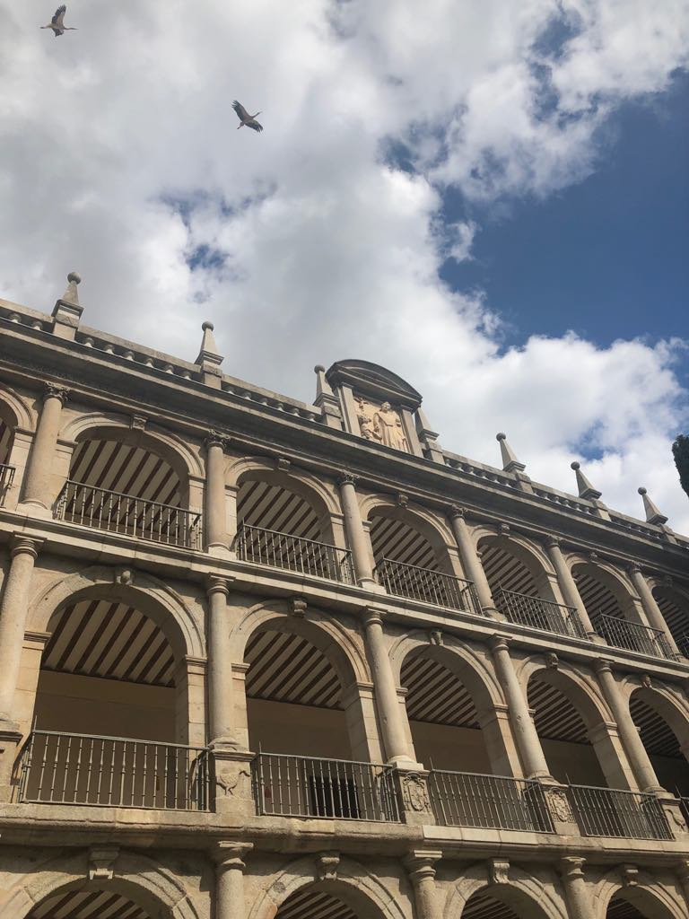
Návšteva univerzity v Alcale Visit of University in Alcala

Slide 8
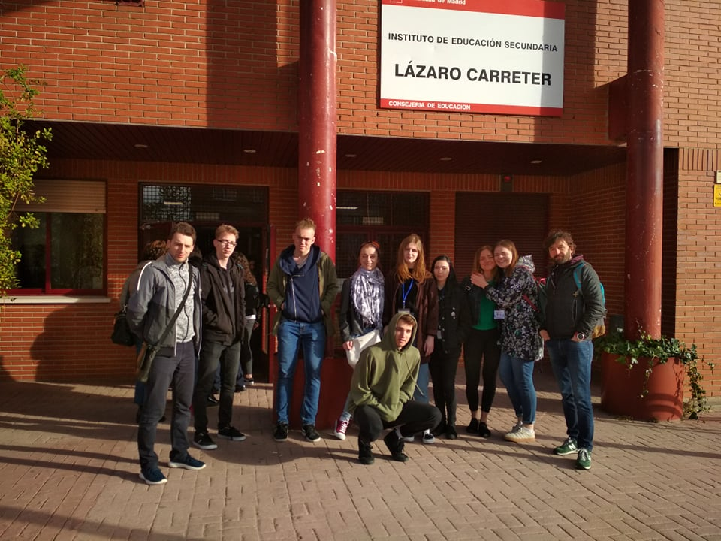
Škola v Španielsku School in Spain
Navštívili sme aj ich školu. Táto škola funguje podobne ako naše gymnázia. Celý čas našej návštevy sme mali spoločné aktivity.
- We also visited their school which works almost like our grammar schools. All the time of our visit we were doing many different activities.

Slide 9
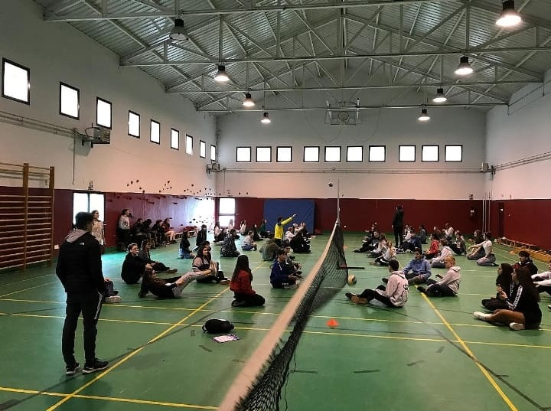
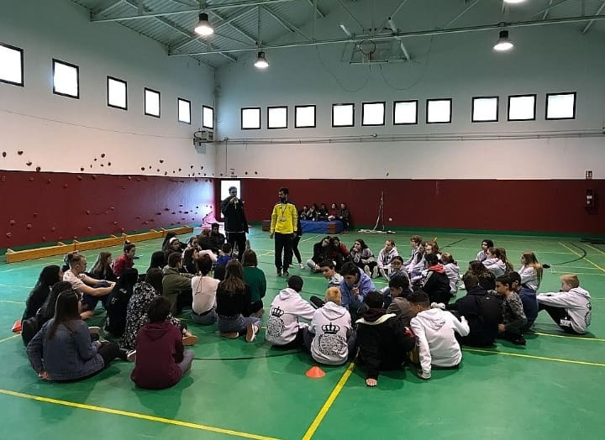
Športové aktivity Sport activities
Boli sme rozdelení do tímov, v ktorých boli žiaci z rôznych krajín.
-We were divided into teams in which were the students from different countries

Slide 10
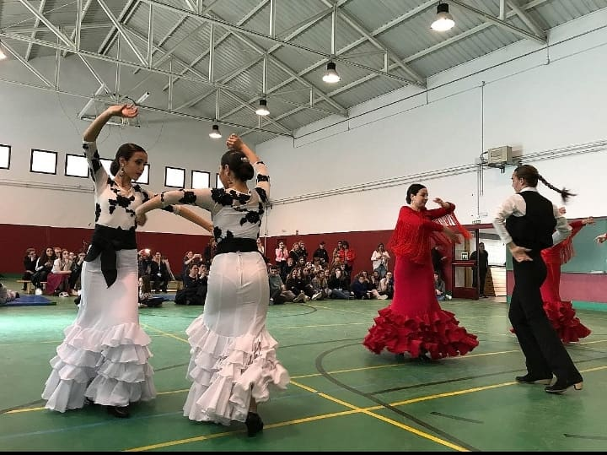
Kultúrny program Culture program
Predviedli nám tradičné španielske tance.
-They showed us their traditional Spanish dance

Slide 11
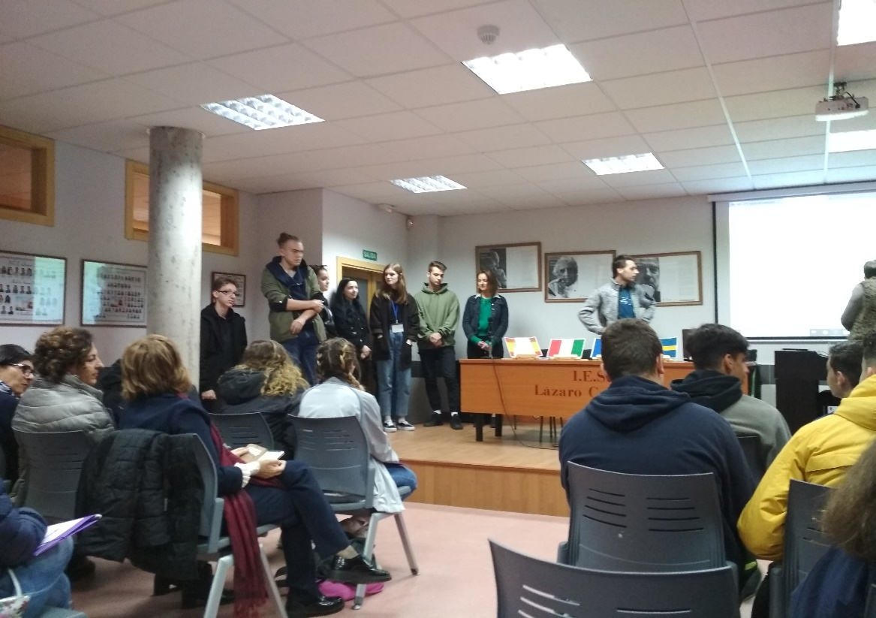
Na druhý deň sme navštívili školu. Rozprávali sme o výsledkoch dotazníka o rôznorodosti, ktorý vypracovávali žiaci našej školy.
The second day we visited shool. We spoke about the results of questionare, which was made by our students

Slide 12
Ďakujeme za pozornosť Thank you for your attention

