Slide 1
CROTONE

Slide 2
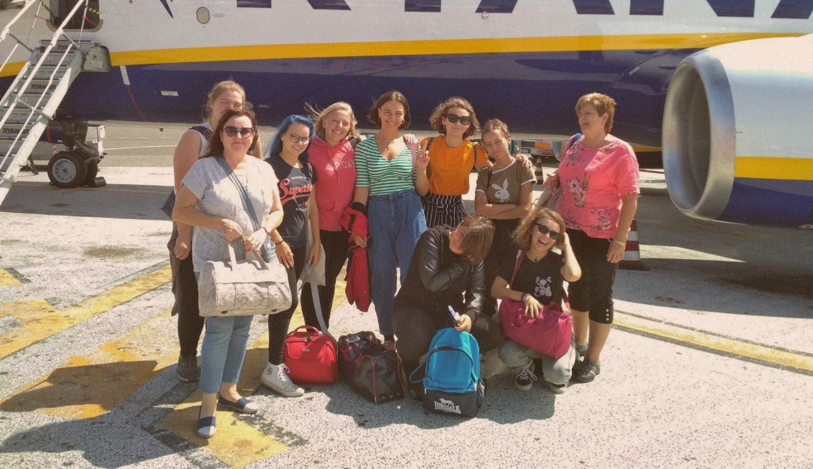
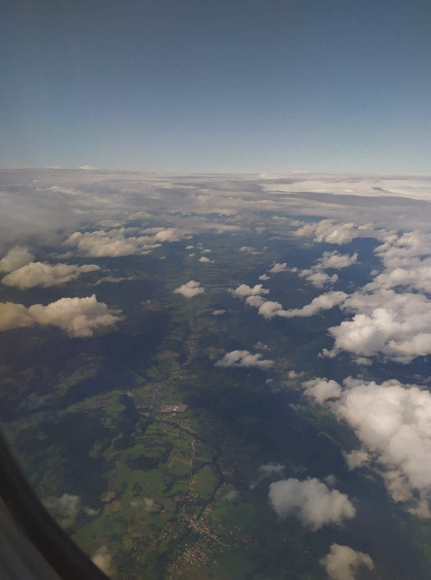
THE DAY OF OUR FLIGHT Sunday – sep. 8th 2019
The day of our flight was stressful but exciting at the same time. We departed from airport in Krakow at around 11AM. After two hours we arrived at the Lamezia Terme airport and we were so happy to be in the Italy finally!
Deň nášho odletu bol stresujúci, no zároveň plný vzrušenia. Odleteli sme z Krakova okolo 11hod. Po dvoch hodinách sme prileteli na letisko do Lamezia Terme a tešili sme sa, že sme konečne v Taliansku.

Slide 3
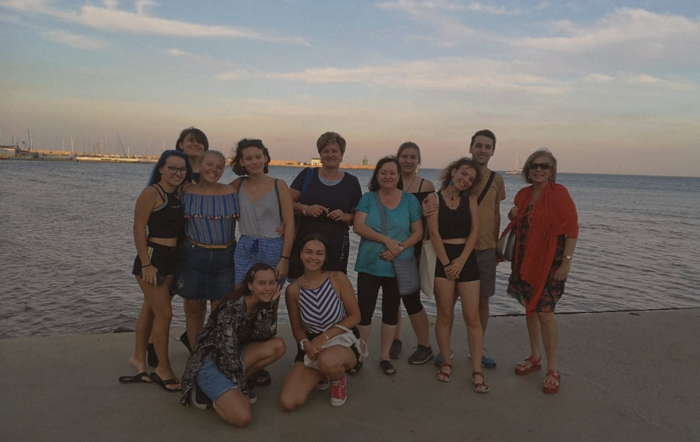
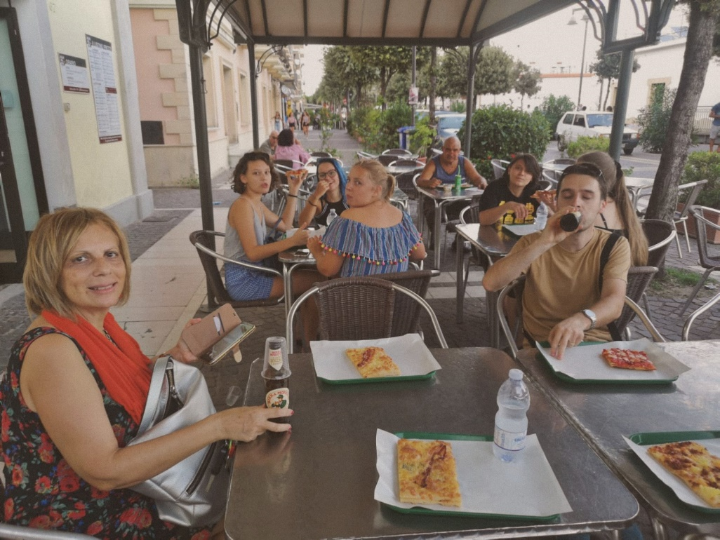
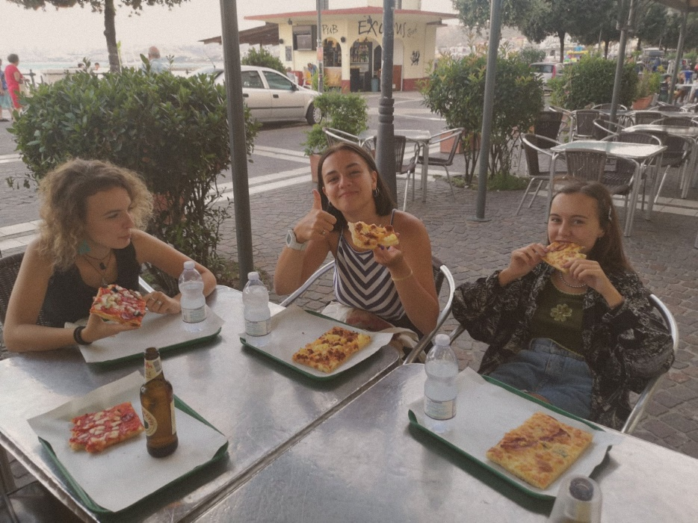
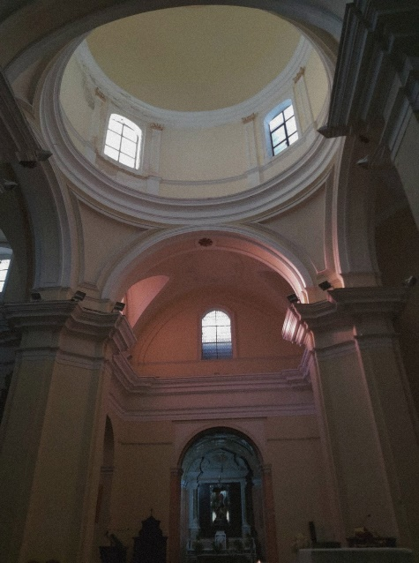
We were blessed by an amazing summer weather and beautiful landscapes. We went to our hostel and later we went to the town. We were walking and saw so many historical and breathtaking buildings. Then we had a delicious pizza!
Boli sme obdarení úžasným letným počasím a krásnou krajinou. Šli sme na ubytovňu a neskôr sme sa vybrali do mesta. Na prechádzke sme videli mnoho historických a dych vyrážajúcich budov! Potom sme si dali chutnú pizzu.

Slide 4
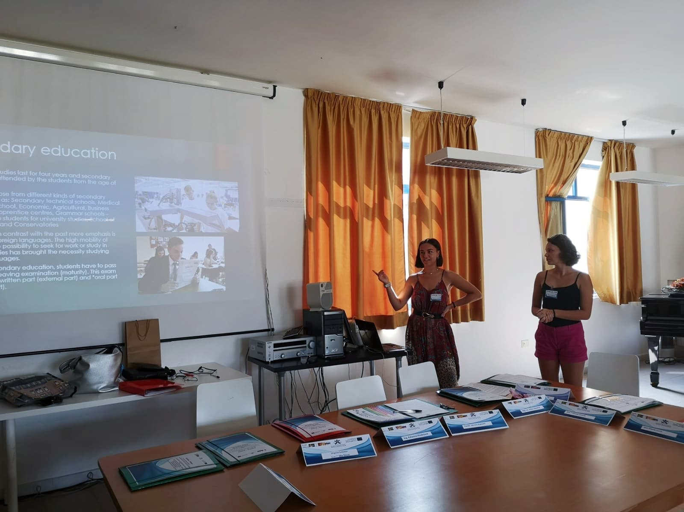
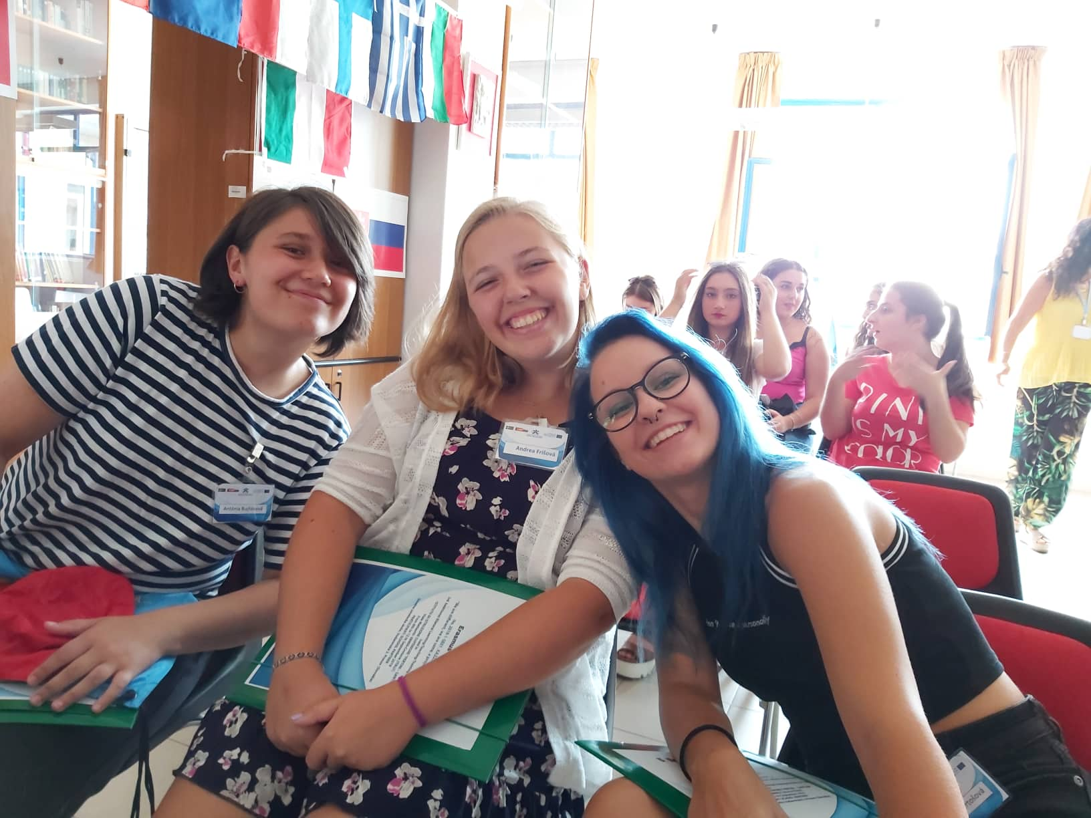
Day 1 Monday – sep. 9th 2019
After waking up in our beautiful hostel, at 8:40 the Italian teachers, Ornella and Alberto, picked us up to take us to Pertini Santoni School. We went to the library where the presentations about our countries were held. After their presentation about Italy we had a short break where we could socialize with the students and teachers and also try some of their pastries. After the break we took turns presenting Slovakia, its food and traditions.
Po zobudení v našom krásnom hosteli, nás Ornella a Alberto odprevadili do školy Pertini Santoni V knižnici sme prezentovali naše krajiny, náš folklór a tradičné jedlá a po krátkej prestávke, na ktorej sme sa spoznávali so žiakmi a učiteľmi z Talianska, sme sa presunuli do druhej budovy školy.

Slide 5
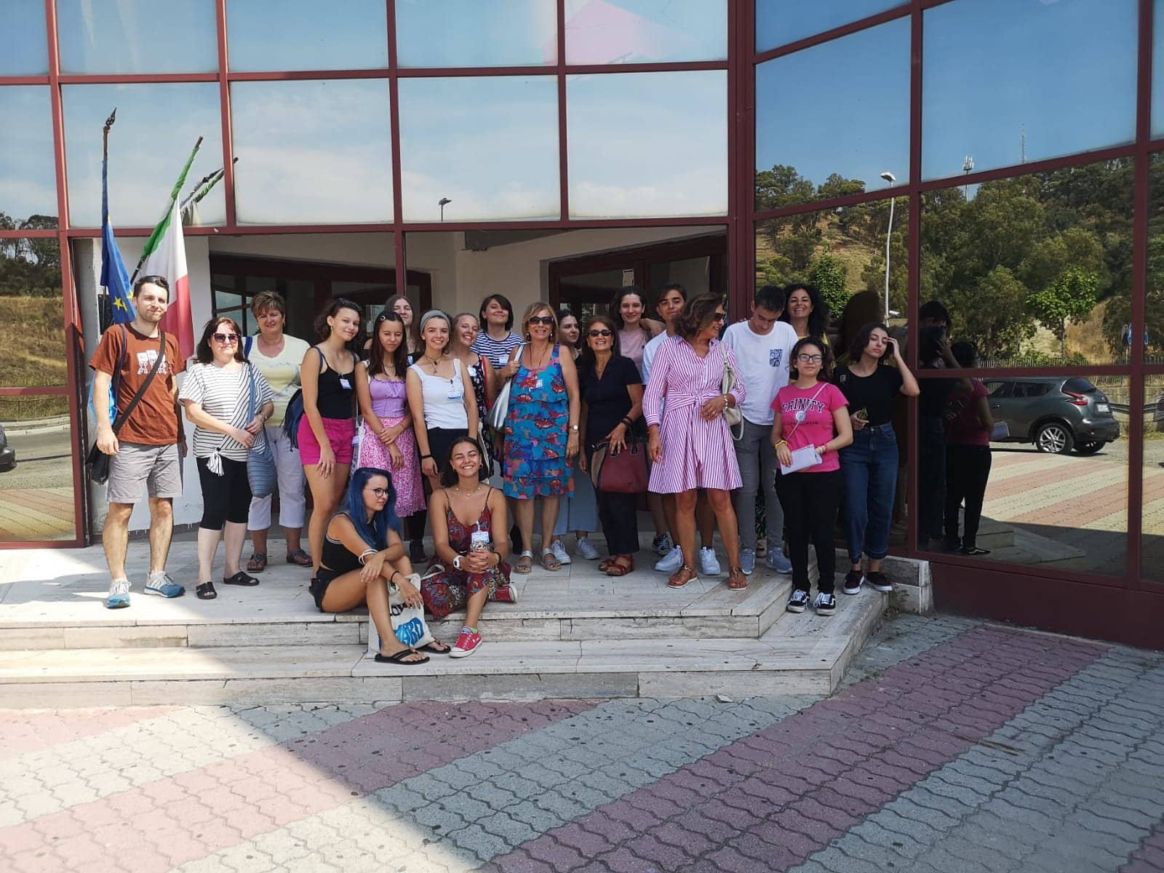
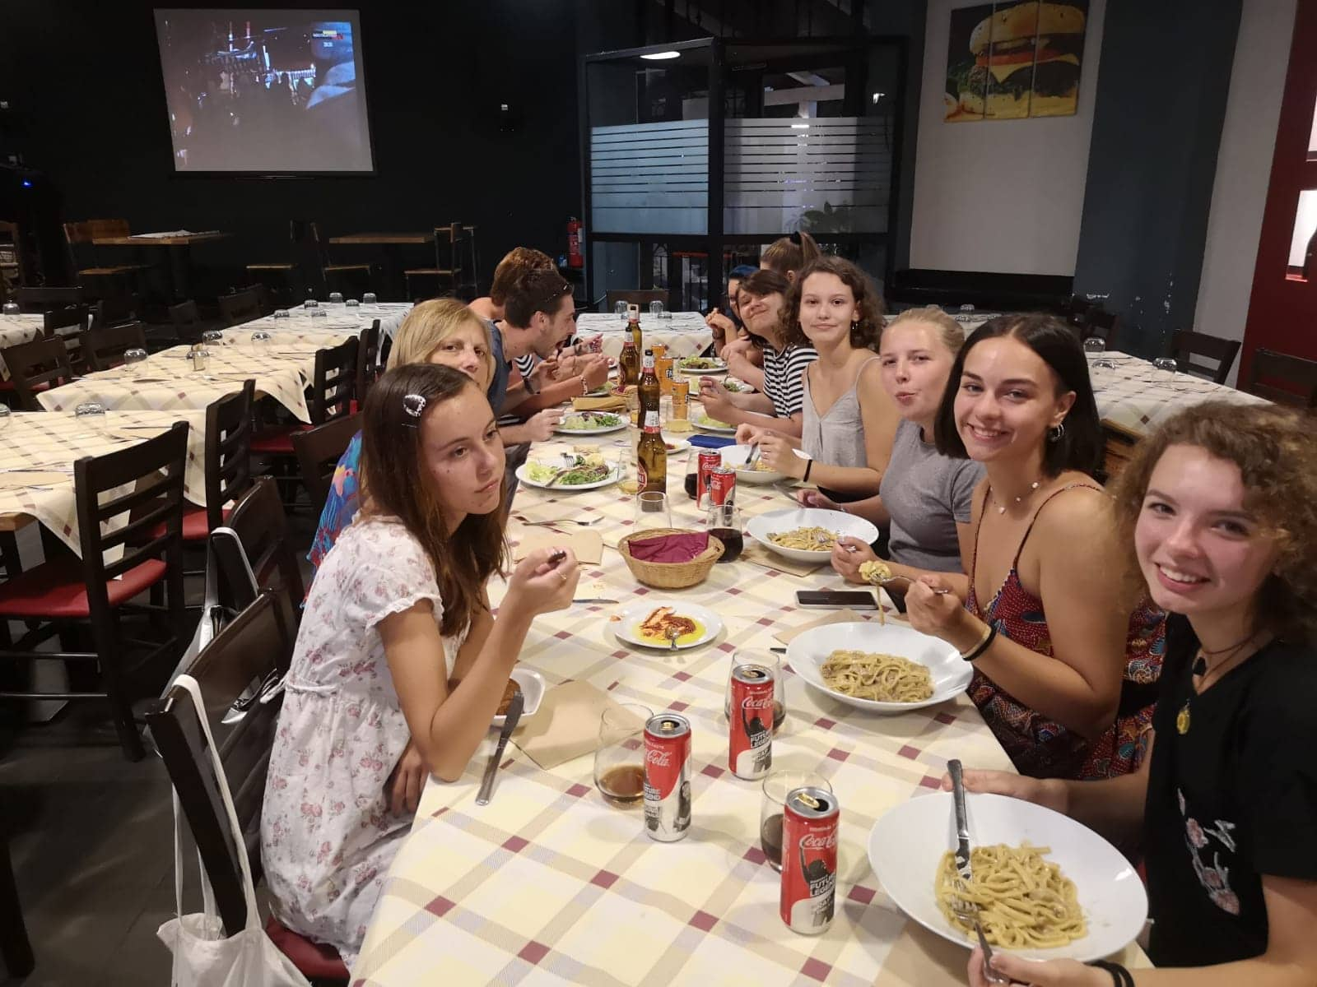
When we finished presenting we went to visit the school´s second building.
The students showed us their artworks and studios.
Then we had lunch, went back to the hostel and got ready for the beach.
At the beach we met the PE teacher and we played beach volleyball.
After that we went for a swim in the sea.
We ended our day with some delicious dinner at an Italian restaurant.
Po príchode do druhej budovy nám žiaci ukázali ich ateliéry a diela
Naobedovali sme sa a vrátili na hostel, kde sme sa prichystali na pláž
Na pláži sme sa stretli s učiteľom telocviku a zahrali sme si plážový volejbal.
Napokon sme si išli zaplávať. Deň sme zakončili chutnou Talianskou večerou.

Slide 6
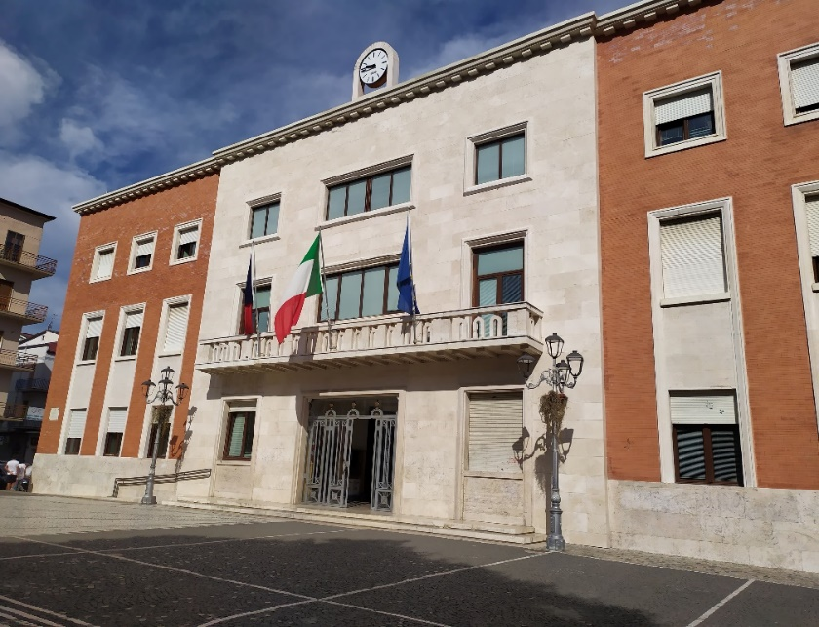
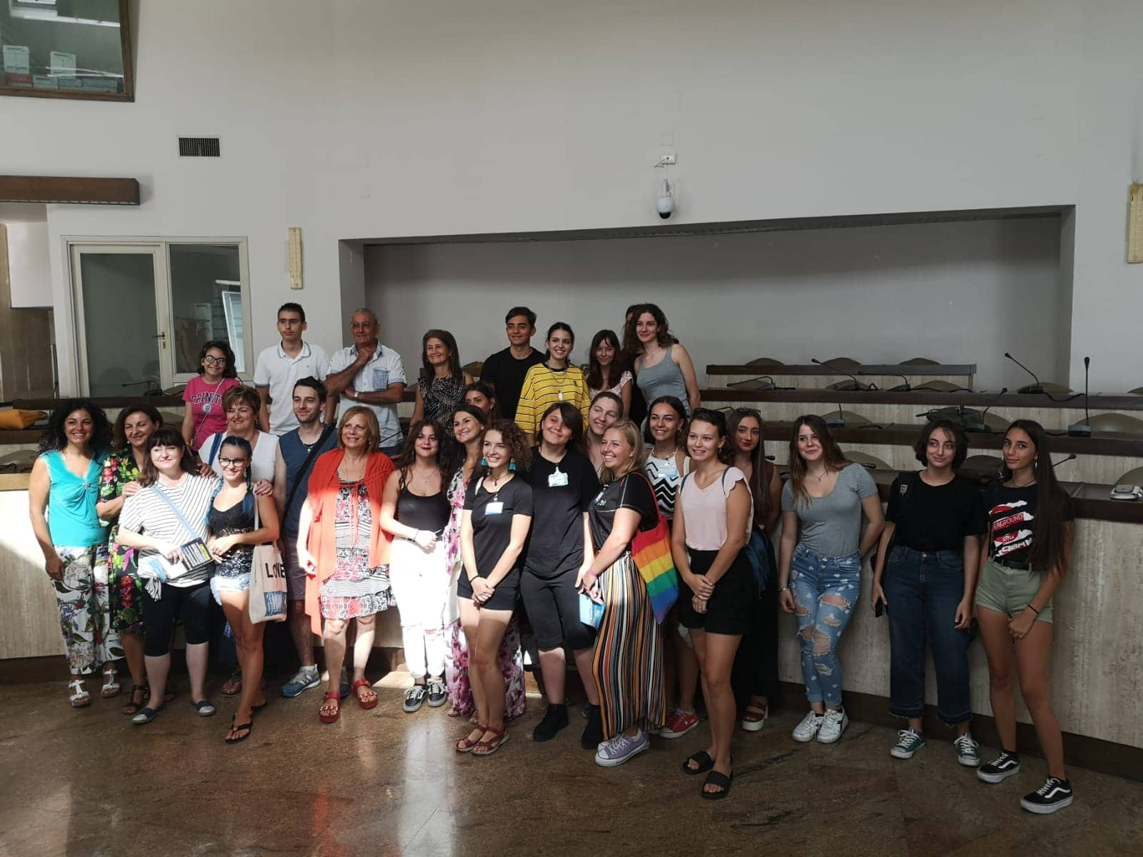
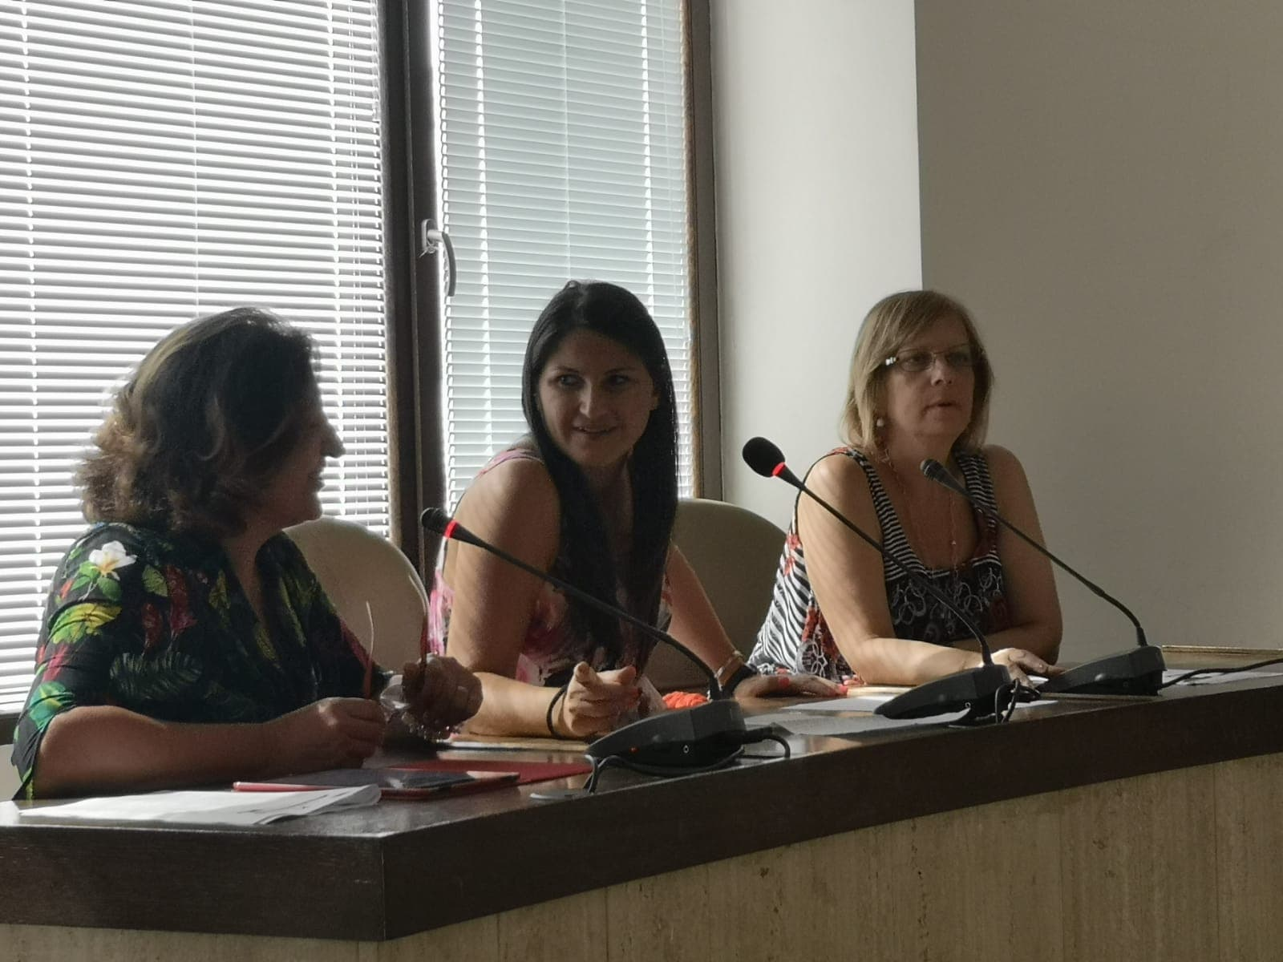
Day 2 Tuesday – sep. 10th 2019
As soon as we woke up we went to have a breakfast. Then Alberto picked us up from B&B at 9:30. We walked
to Crotone Town Hall. The Mayor welcomed us there. She presented Erasmus project with the Italian teacher. After presentation local television came to the Town Hall to film us.
Hneď ako sme sa zobudili išli sme na raňajky. Potom nás Alberto vyzdvihol pri B&B o 9:30. Potom sme išli na mestský úrad v Crotone. Tu nás privítala primátorka mesta Crotone. Primátorka spolu s talianskou učiteľkou odprezentovali projekt Erazmus. Po prezentácií nás prišla na mestský úrad natočiť miestna televízia.

Slide 7
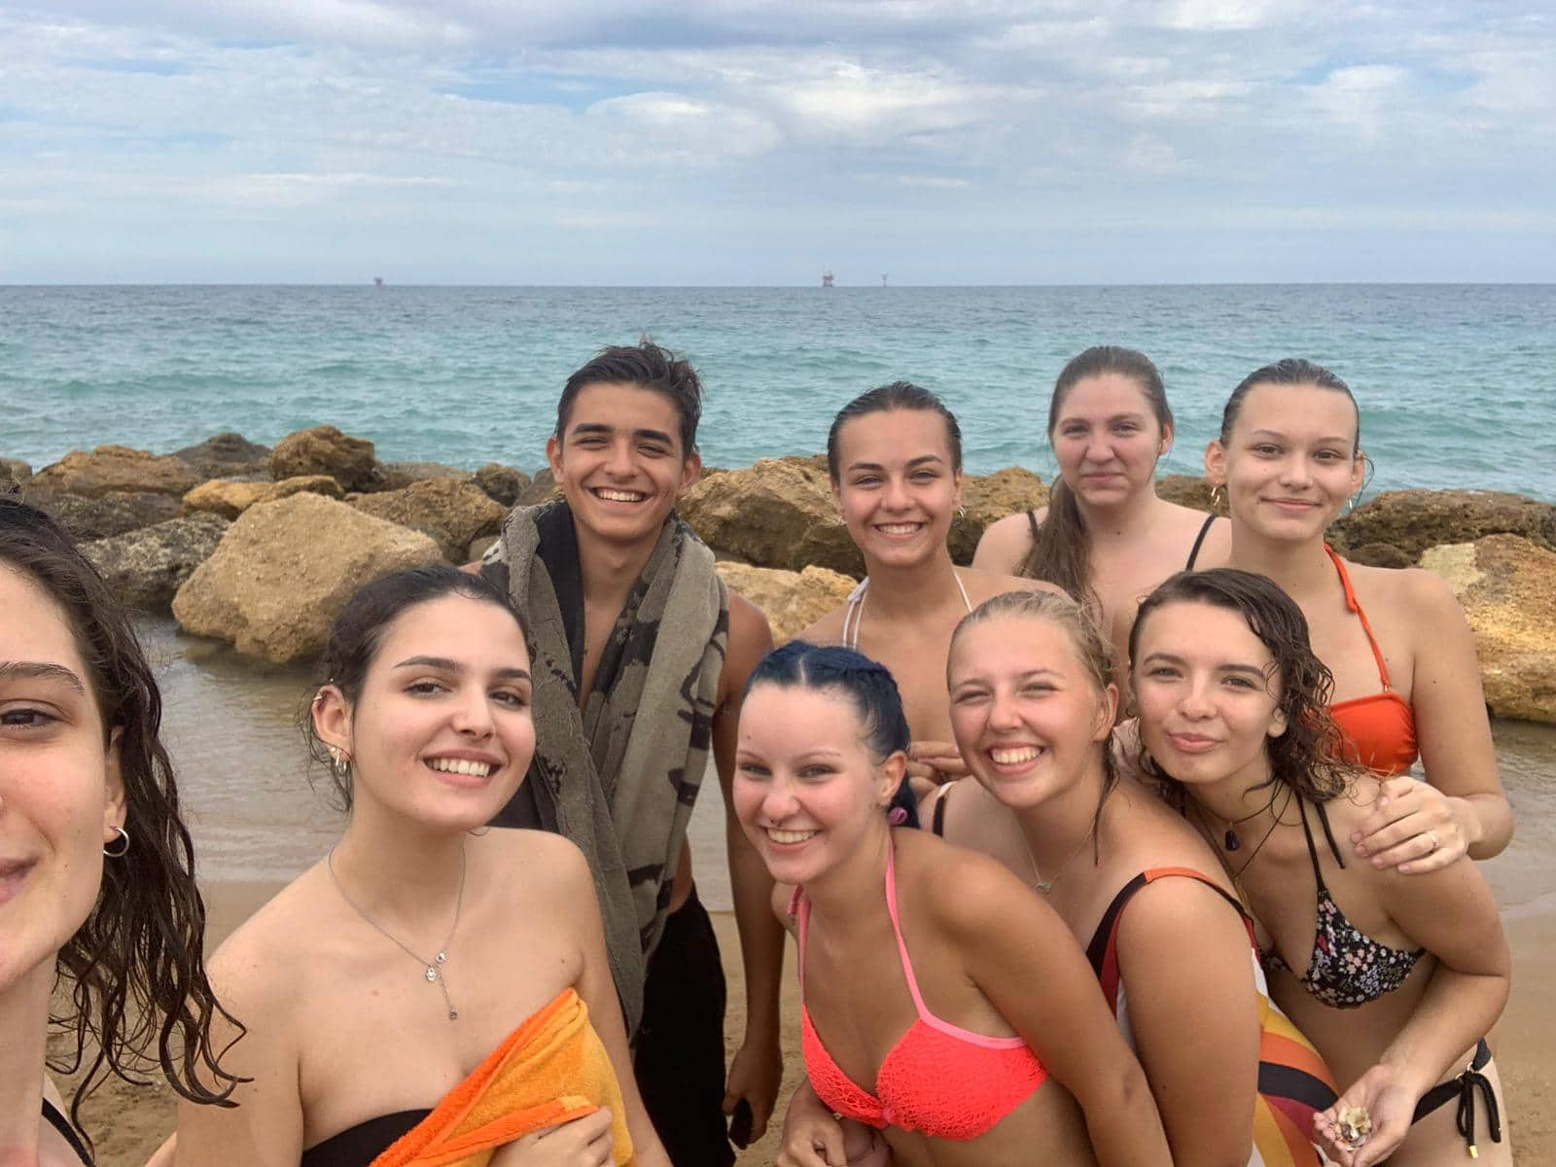
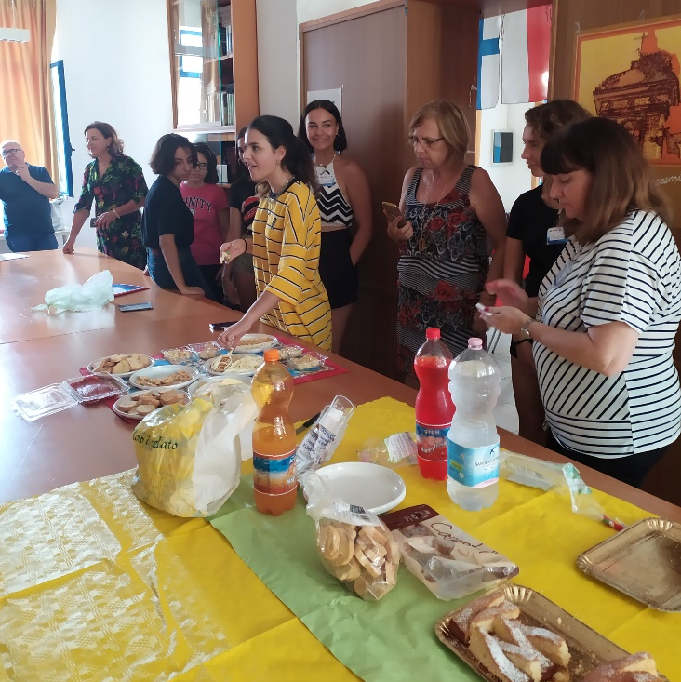
Then we went to school where we had an intercultural exhibition with food, clothing, photographs and music from each partner school. After school we had lunch at fast food offered by hosting school. We went to the beach with the Italian students after the lunch.
Potom sme išli do školy. Tu sme mali medzikultúrnu exhibíciu s jedlom, oblečením, fotografiami a hudbou z ostatných partnerských škôl. Potom sme mali obed v rýchlom občerstvení ponúknutý partnerskou školou. Po obede sme išli na pláž s talianskými študentmi.

Slide 8
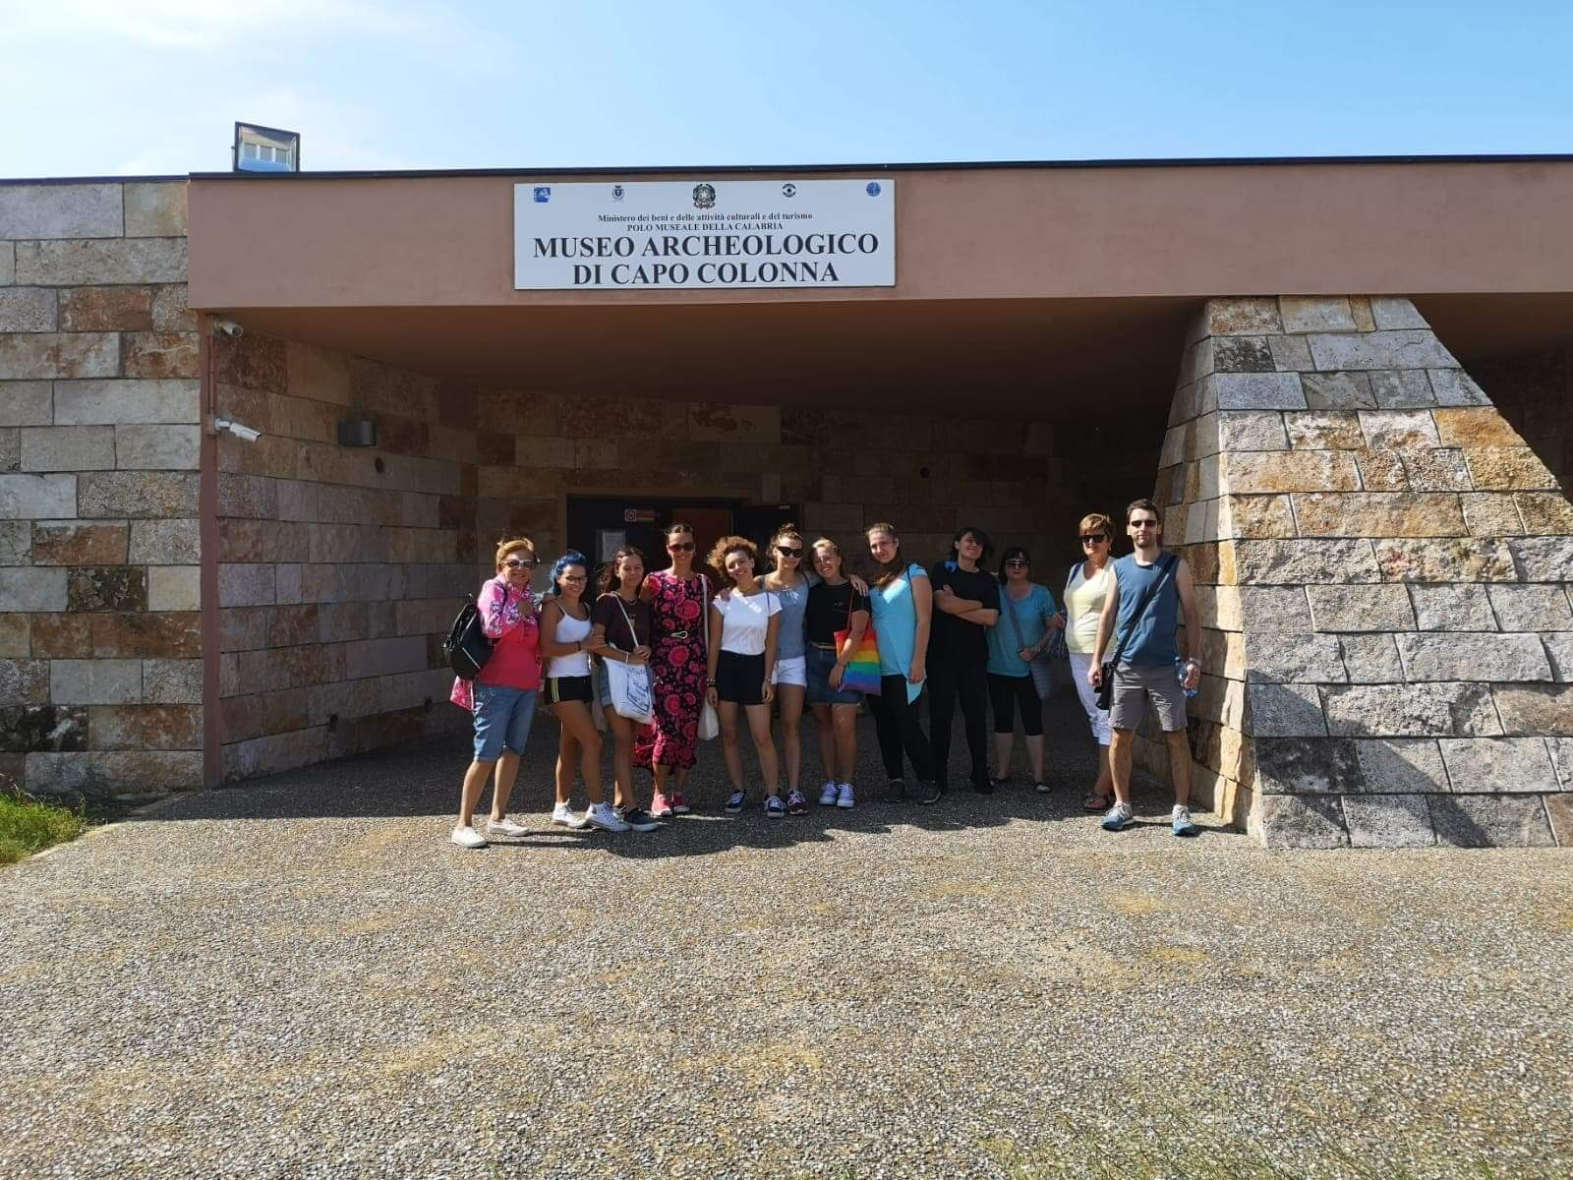
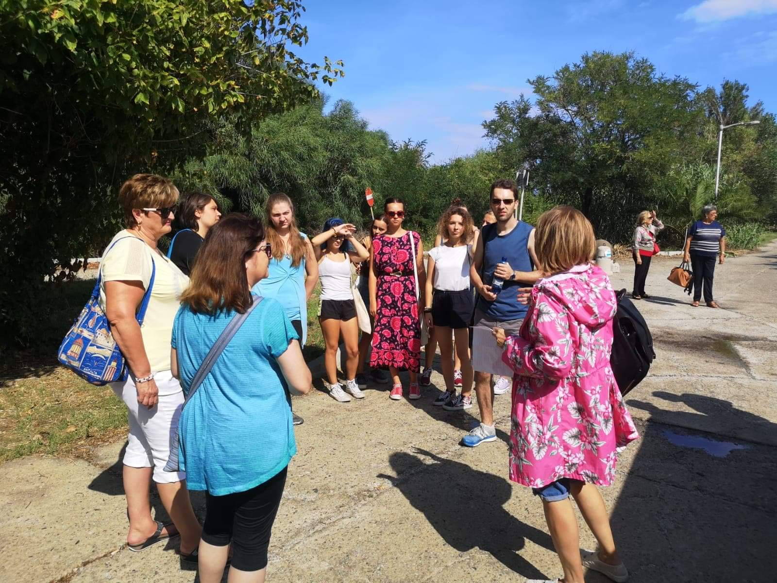
Day 3 Wednesday – sep. 11th 2019
On the third day we came to Capo Colonna to visit National Archaeological Museum and Archaeological Park of Capo Colonna. This area was located in very windy location but it was still very hot. Our coordinator Ornella gave us some historical information about museum and archaeological park before we came in.
Na tretí deň sme navštívili v Capo Colonna Medzinárodné Archeologické Múzeum a Archeologický park. Lokácia tohto múzea sa nachádzala na veľmi veternom území, no i napriek tomu bolo veľmi horúco. Predtým, ako sme vstúpili, nám naša koordinátorka Ornela, poskytla historické informácie o múzeu a parku.

Slide 9
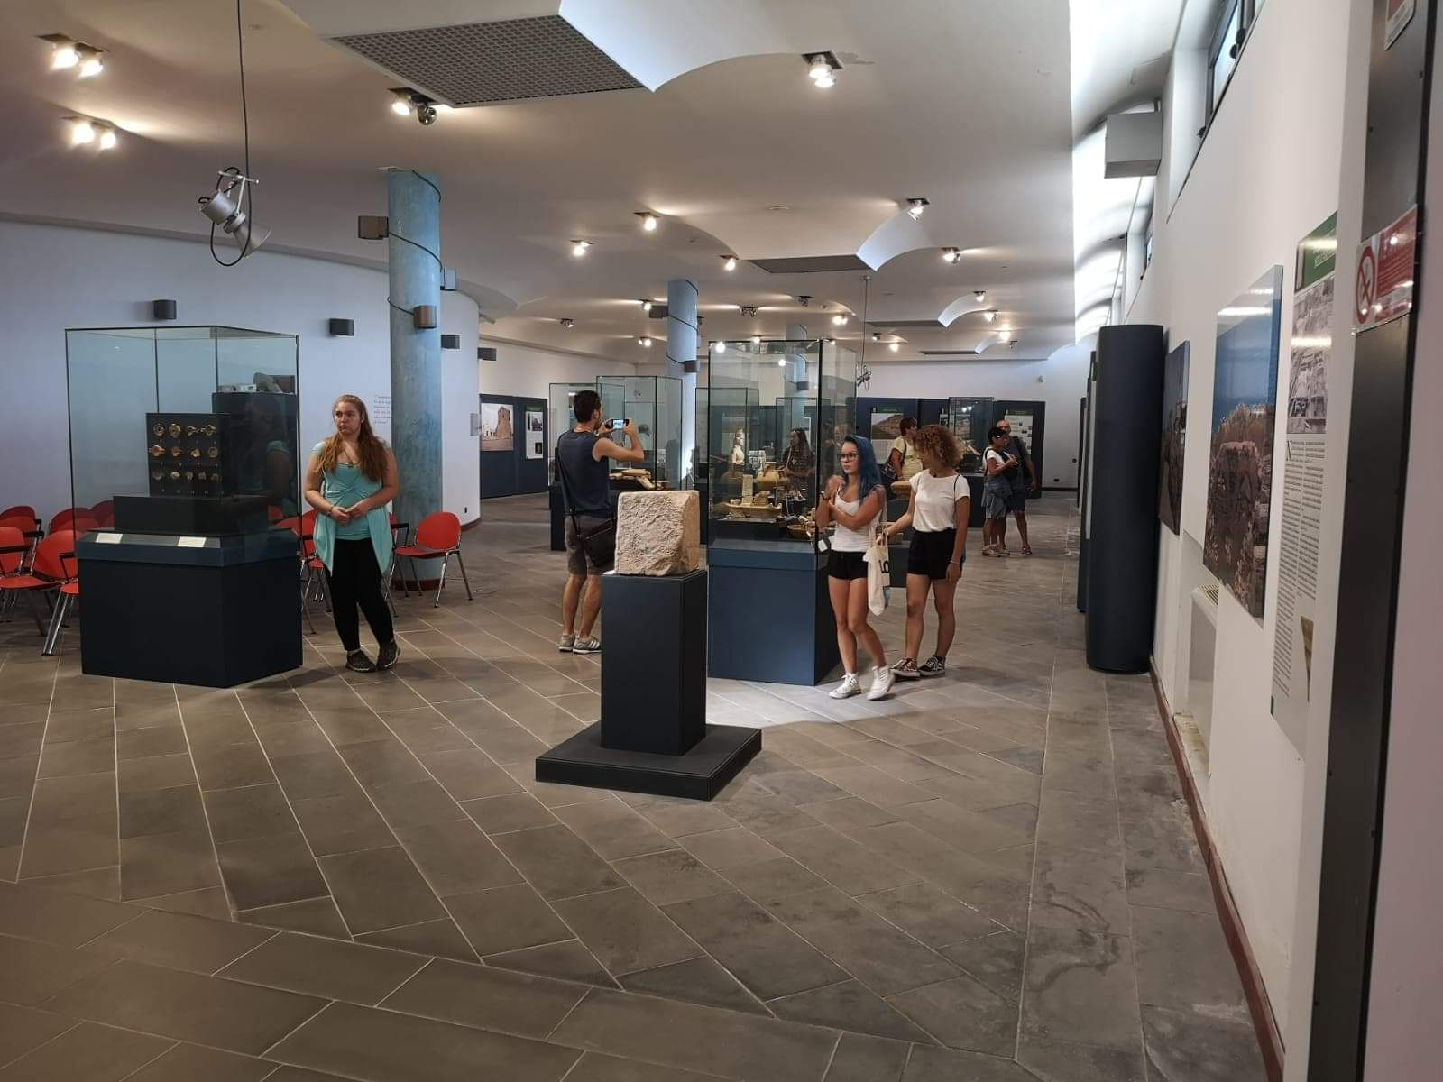
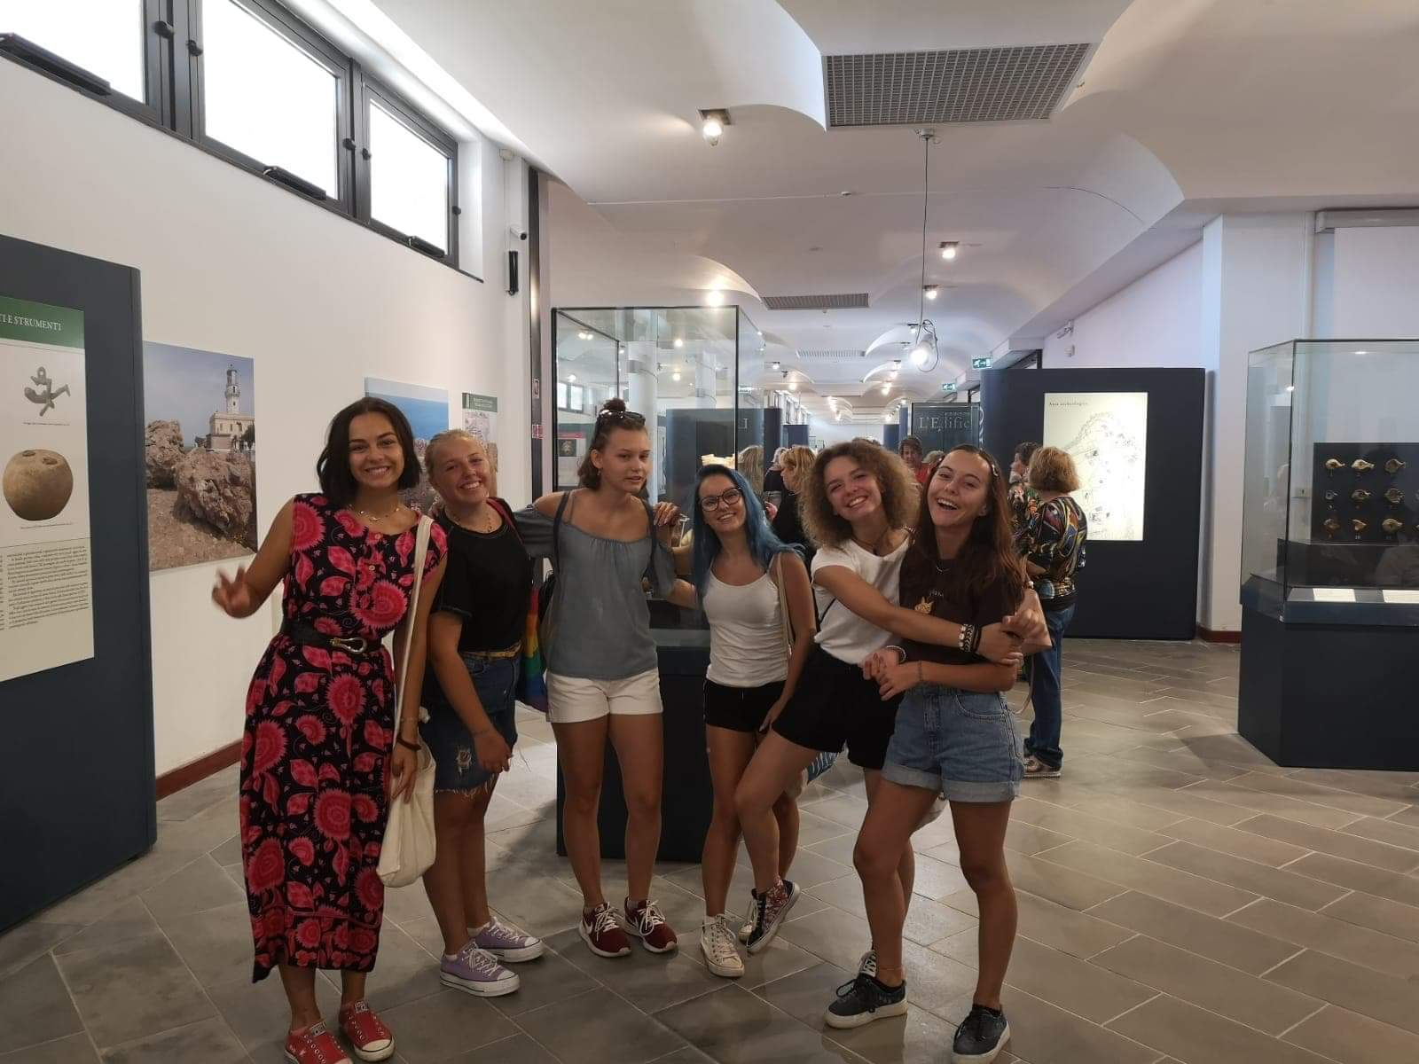
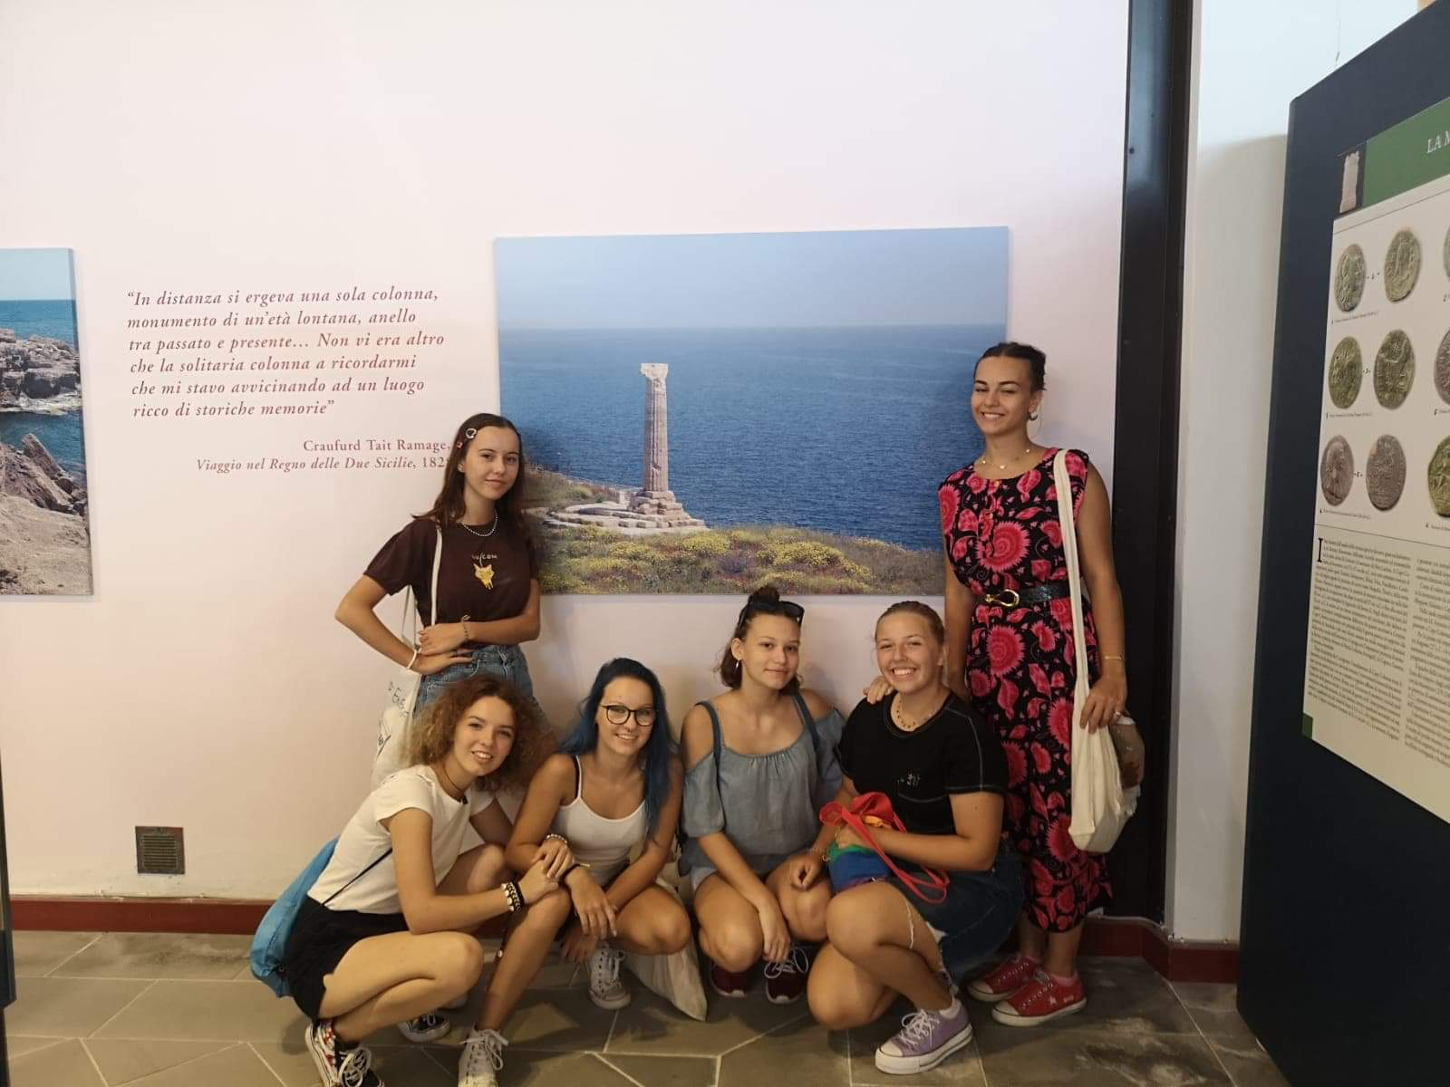
Inside the archaeological museum we could see many artefacts like coins, earrings, bowls, small statuary, remains of columns and statuaries. Also there was a section where were artefacts which were caught from the sea. We really enjoyed the time in this museum because it was different from our Slovak museums.
V múzeu sme mohli vidieť veľa artefaktov ako mince, náušnice, misky, malé sošky, pozostatky z stĺpov a sôch. Taktiež, sa tam nachádzala sekcia s artefaktami, ktoré boli vylovené z mora. Veľmi sme si užili čas strávený v tomto múzeu, pretože bolo odlišné od našich slovenských múzeí.

Slide 10
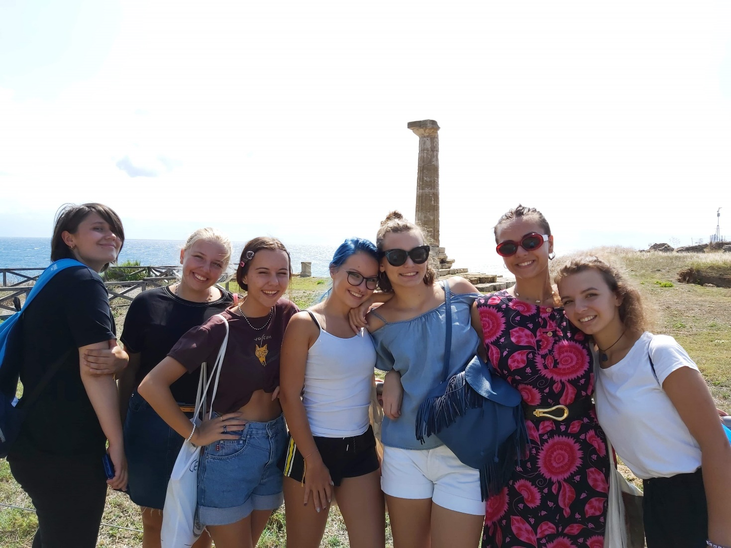
Behind of us you can see a Doric column which dates back to the sixth century BC. This is the last survivor of the 48 columns that supported the roof of the great temple of the goddess Hera Lacinia. The reason why there is only one column is there was a earthquake and everything fell into the sea.
Za nami môžeme vidieť dórsky stĺp zo 6. storočia pred Kristom. Tento stĺp je jediný zachovaný stĺp zo 48 stĺpov, ktoré podopierali strechu chrámu bohyne Héry. Príčinou prečo stĺpy spadli, bolo zemetrasenie a následne všetko spadlo do mora.

Slide 11
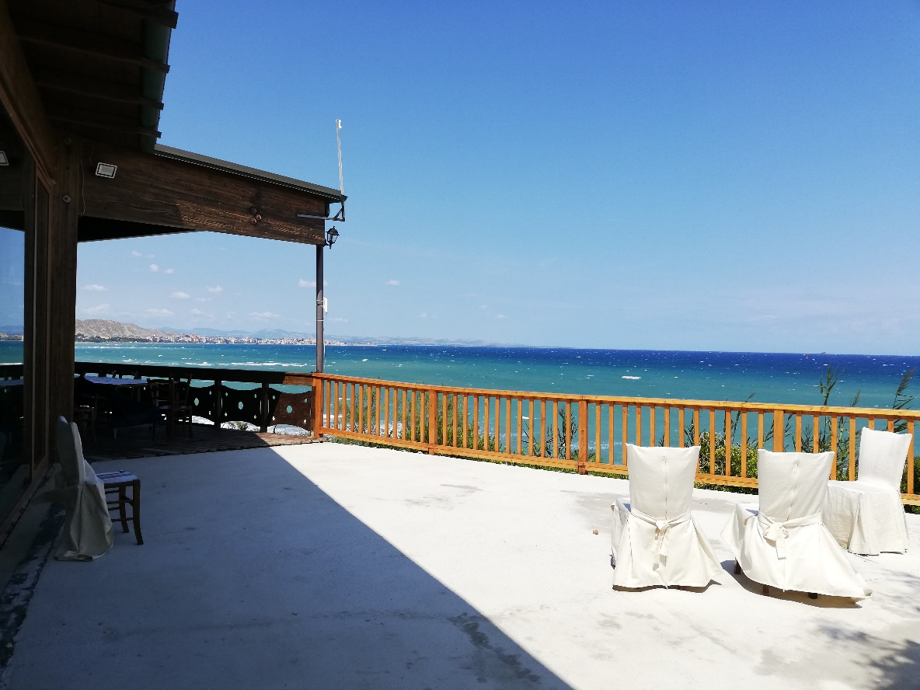
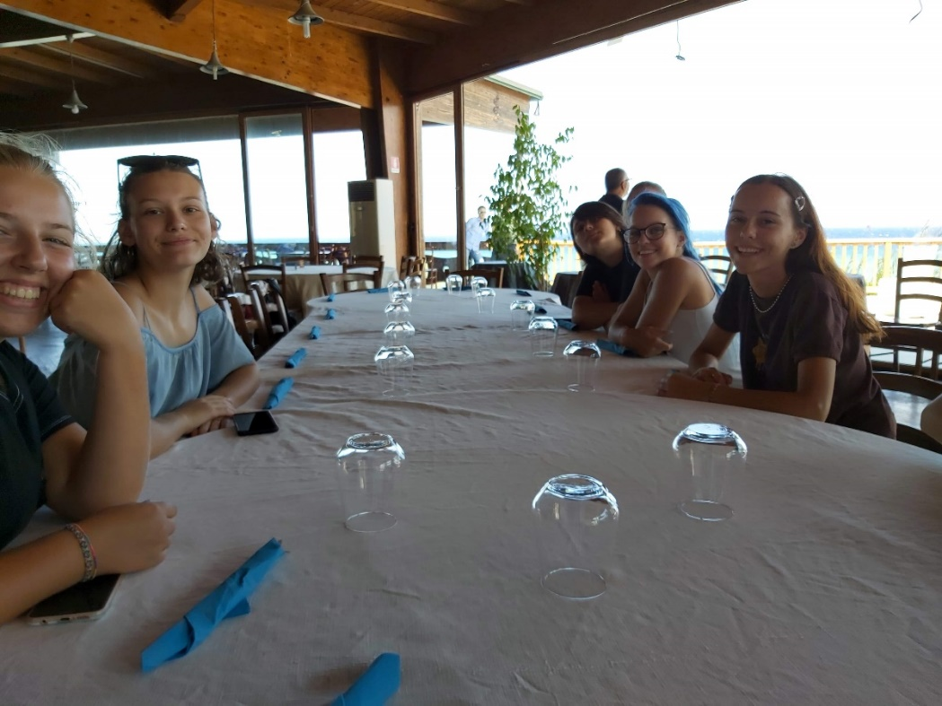
After visiting museum we came to the restaurant at the seafront with a beautiful view. For lunch we had typical Italian pasta with melted meat, tomato paste and parmesan. Before main meal we had appetizer which was toasted bread with sliced tomatoes, olive oil and fried minced meat. For dessert we had two kind of ice-creams one chocolate and the other one was peanuts . The whole menu was very good.
Po návšteve múzea sme navštívili reštauráciu s pekným výhľadom na more. Na obed sme mali typické talianske špagety s mletým mäsom, paradajkovým pretlakom a parmezánom. Pred hlavným jedlom sme mali predjedlo, čo bola hrianka s kúskami paradajok, olivovým olejom a vyprážaným mletým mäsom. Na dezert sme mali dva druhy zmrzliny, jedna bola čokoládová a druhá oriešková. Celé menu bolo veľmi dobré.

Slide 12
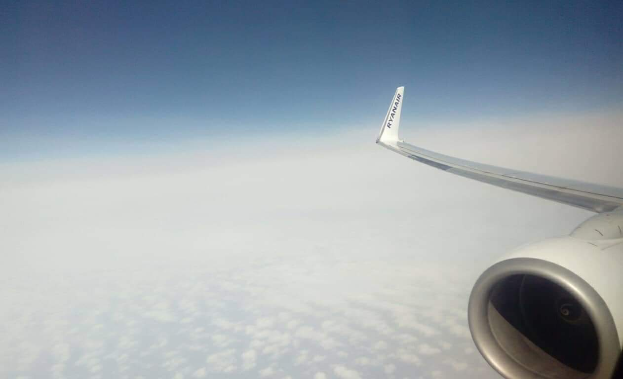
BACK TO SLOVAKIA Thursday – sep. 12th 2019
Our way to home was good. As we came to Crotone, we also left. The drivers drove us to Lamezia Terme airport by minivans from Crotone at 5:30am. Weather for flight was great and we also had a beautiful view out of airplane. Italians next to us were very talkative and kind to us ☺ We enjoyed the flight.
Naša cesta domov bola dobrá. Tak, ako sme prišli do Crotone sme tiež aj odchádzali. Vodiči nás odviezli na letisko v Lamezia Terme minivanmi už o 5:30 ráno z Crotone. Počasie bolo pre let skvelé a taktiež aj výhľad z lietadla bol prekrásny. Taliani sediaci vedľa nás boli veľmi zhovorčiví a milí ☺. Let sme si užili.

Slide 13
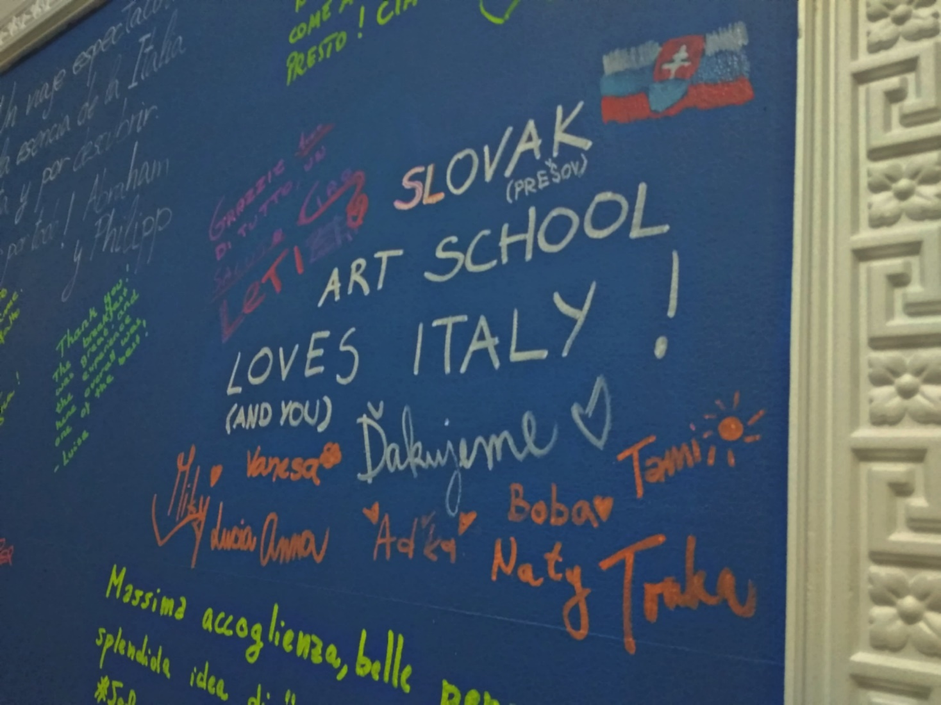
Thank you very much for your time that you have spent with us <3

