Slide 1
BULLYING/CYBERBULLYING
Sofia Havirová

Slide 2
Bullying
- Bullying is a form of agressive behavior, designed to hurt another with
imbalance of power.
- It’s unwanted psychical or verbal aggression directed at a
specific person, with reason to make fun of them.
- People usually think that bullying is only on school but it can be also in the
work between an adult people.

Slide 3
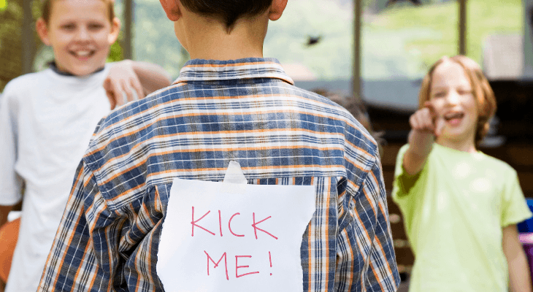
Types of bullying
We have 3 types of bullying.
Verbal bullying is saying or writing mean things
- Name-calling,
- Teasing,
-Taughting
Social bullying, sometimes reffer to as relational bullying, involves hurting
someone’s reputation or relationships
- Spreading rumors about someone
- Embarrasing someone in public
- Telling other children not to be friends with someone
Psychical bullying involves hurting a person’s body or possession
- Hitting/Kicking/Pinching
- Pushing
- Taking or breaking someone’s things

Slide 4
How can we notice that
When the childrens are bullied they may show sings when we can see that something
bad is happening. They may have:
- Have trouble getting out of bed
- Not want to go to school
- Change their sleeping or eating patterns
- Have frequent tears, anger, mood swings and anxiety
- Have unexplained bruises, cuts and scratches
- Bad marks in fast time
- Always stressed, stop talking

Slide 5
Cyberbullying
- It’s bullying throught digital devices also know as online bullying
That includes sending , posting and sharing harmful, false or mean content.
The most common places where cyberbullying occurs are:
- Social media ( Instagram , Facebook, Snapchat)
- SMS
- Emails
But also even cyberbullying have 2 types :
- Cyberstalking , it’s used to stalk victim witch it’s more dangerous
- Trolling , they’re just tryin to provoke or offend others.

Slide 6
What is a difference ?
- The difference is that in bullying we can notice that and it’s possible to find an aggressor and stop it.
- While with cyberbullying it’s not so easy, people can blackmail us, threaten us with harm or even death.
- We have cases such as a blue whale, in which case the aggressor is harder to find, you need to find help as police, they will help you. They can find aggressor by his using IP adress.

Slide 7
Why?
- Kids can bully because they see this in parents, they have less attention from them,
They feel unhelpful or to the kids is given too much power, or they are just still kids.
- They can bully someone because they are jelaous ( they are not talented or popular)
Or when the victim is weaker and have less friends,
illness, sexual orientation, religious, race or family possition.
- Even kid (aggressor) may have some psychical trouble.
- It is all about how you raise your child, to be good and helpful or to be bad and mean

Slide 8
What is the result ?
This all situations can bring kids to the wrong side.
It all can end up really bad that is why is this all so dangerous.
Kids can:
- Start drinking alcohol or taking drugs
- Fell into depression, start selfharming or have eating disorders
- Or even they can kill themself

Slide 9
HOW CAN WE PREVENT THIS
U have to do something, as:
- Tell someone teacher, parents, your friends or someone who is an adult
- If you are fearfull we also have the help lines, in every country.
- Stand up for people if they are bullied
- Separate bully and and the person being bullied if you can.
Just don’t watch it to happen, do something !!
Help the weaker .

Slide 10
THANK YOU FOR YOUR ATTENTION !

