Slide 1
Bullying
Cynthia Švrlingová
2.a

Slide 2
What is bullying?
Bullying is unwanted, aggressive behavior among school aged children that involves a real or perceived power imbalance. The behavior is repeated, or has the potential to be repeated, over time. Both kids who are bullied and who bully others may have serious, lasting problems.

Slide 3
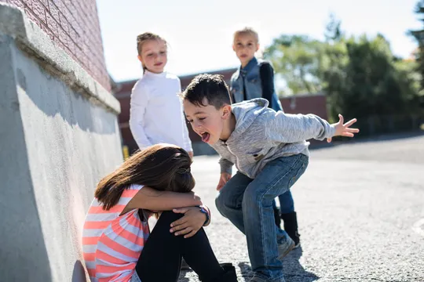
There are 4 types of bullying
1. Verbal bullying
2. Social bullying
3.Physical bullying
4. Cyberbullying
Verbal bullying is saying or writing mean things. Verbal bullying includes:
Teasing
Name-calling
Inappropriate sexual comments
Taunting
Threatening to cause harm

Slide 4
Social and physical bullying
Social bullying, sometimes referred to as relational bullying, involves hurting someone’s reputation or relationships. Social bullying includes:
Leaving someone out on purpose
Telling other children not to be friends with someone
Spreading rumors about someone
Embarrassing someone in public
Physical bullying involves hurting a person’s body or possessions. Physical bullying includes:
Hitting/kicking/pinching
Spitting
Tripping/pushing
Taking or breaking someone’s things
Making mean or rude hand gestures

Slide 5
Cyberbullying
Cyberbullying is bullying that takes place over digital devices like cell phones, computers, and tablets. Cyberbullying can occur through SMS, Text, and apps, or online in social media, forums, or gaming where people can view, participate in, or share content. Cyberbullying includes sending, posting, or sharing negative, harmful, false, or mean content about someone else. It can include sharing personal or private information about someone else causing embarrassment or humiliation. Some cyberbullying crosses the line into unlawful or criminal behavior.
The most common places where cyberbullying occurs are:
Social Media, such as Facebook, Instagram, Snapchat, and Twitter
SMS (Short Message Service) also known as Text Message sent through devices
Instant Message (via devices, email provider services, apps, and social media messaging features)
Email

Slide 6
There are 3 questions: When?
When?
Who?
Why?
Bullying can occur during or after school hours. While most reported bullying happens in the school building, a significant percentage also happens in places like on the playground or the bus. It can also happen travelling to or from school, in the youth’s neighborhood, or on the Internet.

Slide 7
Who?
Bullying can affect everyone: those who are bullied, those who bully, and those who witness bullying. Bullying is linked to many negative outcomes including impacts on mental health, substance use, and suicide.

Slide 8
Kids Who are Bullied
Kids who are bullied can experience negative physical, school, and mental health issues. Kids who are bullied are more likely to experience:
Depression and anxiety, increased feelings of sadness and loneliness, changes in sleep and eating patterns, and loss of interest in activities they used to enjoy. These issues may persist into adulthood.
Health complaints
Decreased academic achievement—GPA and standardized test scores—and school participation. They are more likely to miss, skip, or drop out of school.
A very small number of bullied children might retaliate through extremely violent measures. In 12 of 15 school shooting cases, the shooters had a history of being bullied.

Slide 9
Kids Who Bully Others
Kids who bully others can also engage in violent and other risky behaviors into adulthood. Kids who bully are more likely to:
Abuse alcohol and other drugs in adolescence and as adults
Get into fights, vandalize property, and drop out of school
Engage in early sexual activity
Have criminal convictions and traffic citations as adults
Be abusive toward their romantic partners, spouses, or children as adults

Slide 10
Kids who Assist and Kids who Reinforce:
Kids who Assist:
These children may not start the bullying or lead in the bullying behavior, but serve as an "assistant" to children who are bullying. These children may encourage the bullying behavior and occasionally join in.
Kids who Reinforce: These children are not directly involved in the bullying behavior but they give the bullying an audience. They will often laugh or provide support for the children who are engaging in bullying. This may encourage the bullying to continue.

Slide 11
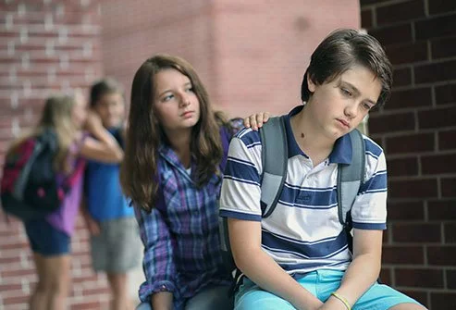
Outsiders and Kids who Defend:
Outsiders: These children remain separate from the bullying situation. They neither reinforce the bullying behavior nor defend the child being bullied. Some may watch what is going on but do not provide feedback about the situation to show they are on anyone’s side. Even so, providing an audience may encourage the bullying behavior.
These kids often want to help, but don’t know how. Learn how to be more than a bystander.
Kids who Defend: These children actively comfort the child being bullied and may come to the child's defense when bullying occurs.

Slide 12
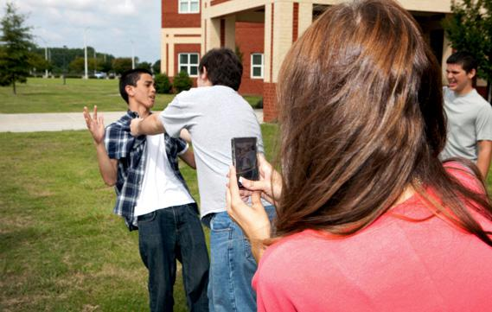
Bystanders
Kids who witness bullying are more likely to:
Have increased use of tobacco, alcohol, or other drugs
Have increased mental health problems, including depression and anxiety
Miss or skip school

Slide 13
And Why?
Generally, children who are bullied have one or more of the following risk factors:
Are perceived as different from their peers, such as being overweight or underweight, wearing glasses or different clothing, being new to a school, or being unable to afford what kids consider “cool”
Are perceived as weak or unable to defend themselves
Are depressed, anxious, or have low self esteem
Are less popular than others and have few friends
Do not get along well with others, seen as annoying or provoking, or antagonize others for attention
Kids may be bullying others if they:
Get into physical or verbal fights
Have friends who bully others
Are increasingly aggressive
Get sent to the principal’s office or to detention frequently
Have unexplained extra money or new belongings
Blame others for their problems
Don’t accept responsibility for their actions
Are competitive and worry about their reputation or popularity

Slide 14
Some signs that may point to a bullying problem are:
Unexplainable injuries
Lost or destroyed clothing, books, electronics, or jewelry
Frequent headaches or stomach aches, feeling sick or faking illness
Changes in eating habits, like suddenly skipping meals or binge eating. Kids may come home from school hungry because they did not eat lunch.
Difficulty sleeping or frequent nightmares
Declining grades, loss of interest in schoolwork, or not wanting to go to school
Sudden loss of friends or avoidance of social situations
Feelings of helplessness or decreased self esteem
Self-destructive behaviors such as running away from home, harming themselves, or talking about suicide

Slide 15
The Relationship between Bullying and Suicide
Media reports often link bullying with suicide. However, most youth who are bullied do not have thoughts of suicide or engage in suicidal behaviors.
Although kids who are bullied are at risk of suicide, bullying alone is not the cause. Many issues contribute to suicide risk, including depression, problems at home, and trauma history. Additionally, specific groups have an increased risk of suicide, including American Indian and Alaskan Native, Asian American, lesbian, gay, bisexual, and transgender youth. This risk can be increased further when these kids are not supported by parents, peers, and schools. Bullying can make an unsupportive situation worse.
Video:
https://www.youtube.com/watch?v=vVt8I_VX558

Slide 16
Thanks for attention
www.stobullying.go

