Slide 1
BULLYING
Daniela Nováková
Livia Kokinčáková

Slide 2
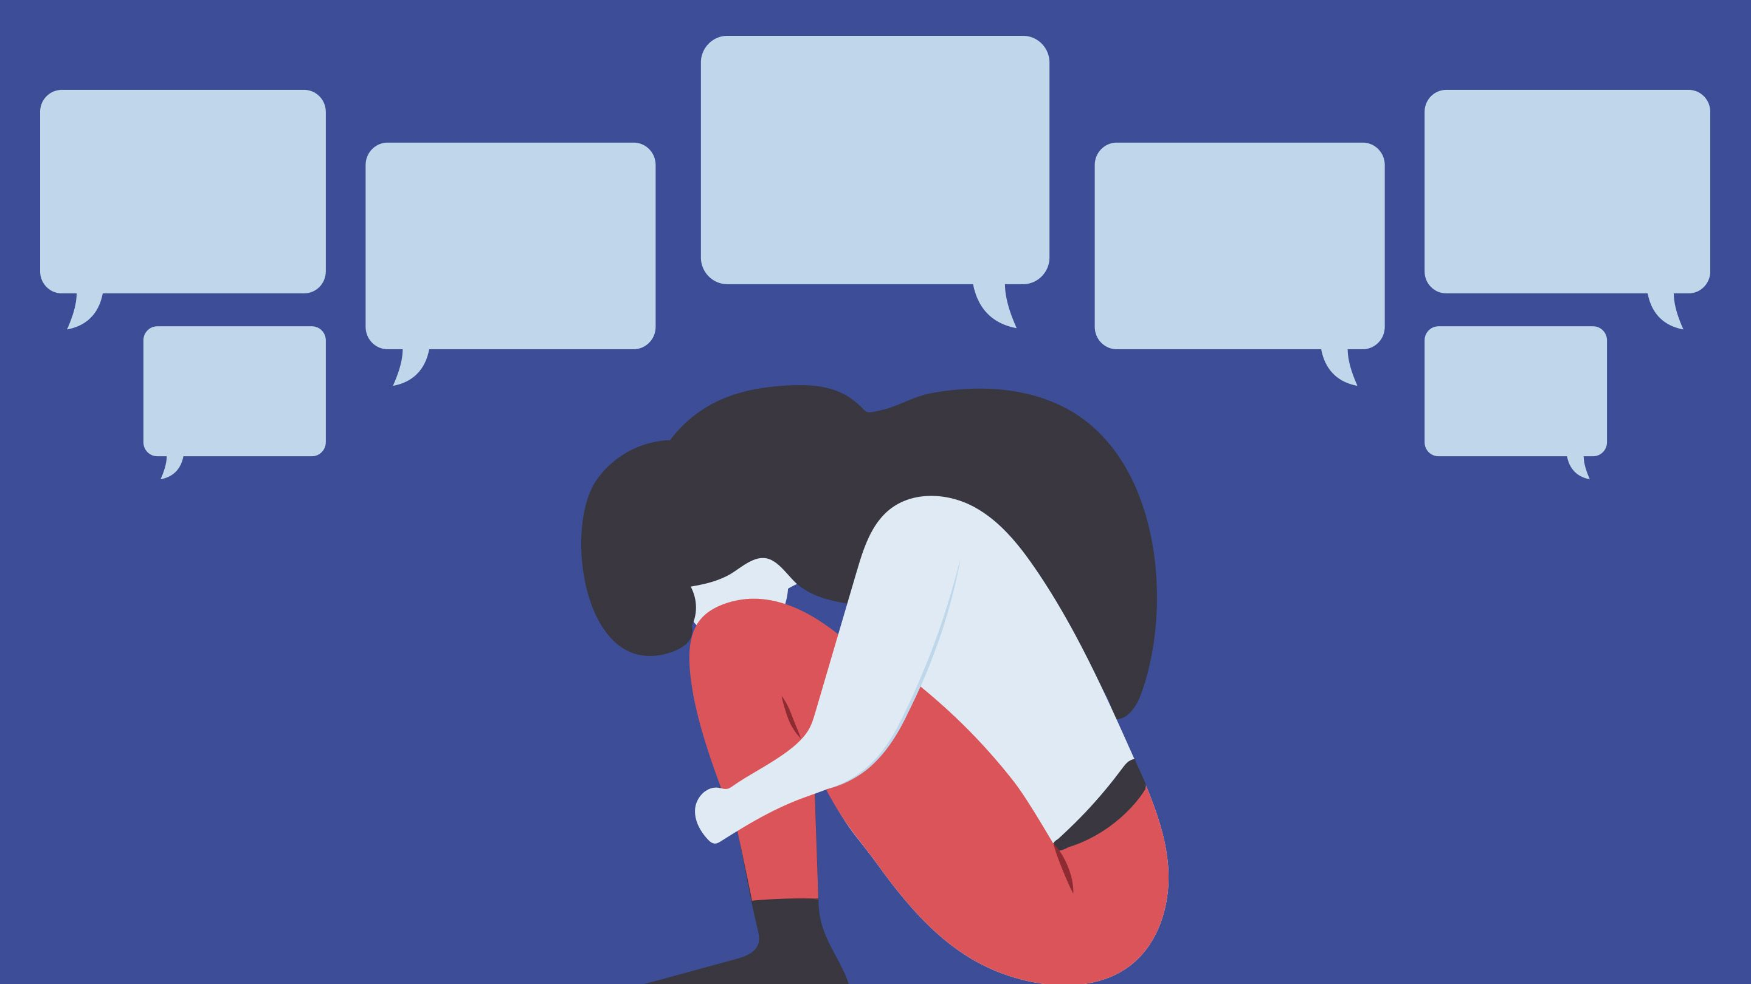
What is bullying?
Bullying is unwanted, aggressive behavior among school aged children that involves a real or perceived power imbalance.
The behavior is repeated, or has the potential to be repeated, over time. Both kids who are bullied and who bully others may have serious, lasting problems.
Bullying can have a serious effect on a child’s mental health and can even lead to the development of anxiety and depression later in life.

Slide 3
Bullies might make fun of others for many things, including:
appearance (how someone looks)
behavior (how someone acts)
race or religion
social status (whether someone is popular)
sexual identity (like being gay, lesbian, or transgender)

Slide 4
Bullying can come in different types:
Physic- is when bullies hurt their targets physically
Verbal- is taunting or teasing someone
Phychological- is gossiping about people to make them feel bad
Cyberbullying- is when bullies use the internet and social media to send mean text, also might post personal information, pictures, or videos designed to hurt or embarrass someone else

Slide 5
How can I help someone who’s being bullied?
Validate their differences. People are often bullied because they’re perceived as different. You can let your child know that their differences deserve to be celebrated.
Listen without judgment. Many of those being bullied are afraid to reach out because they don’t think that what’s going on is a big deal. Let them know that their feelings are valid and that you’re here to listen to as much as they feel comfortable sharing.

Slide 6
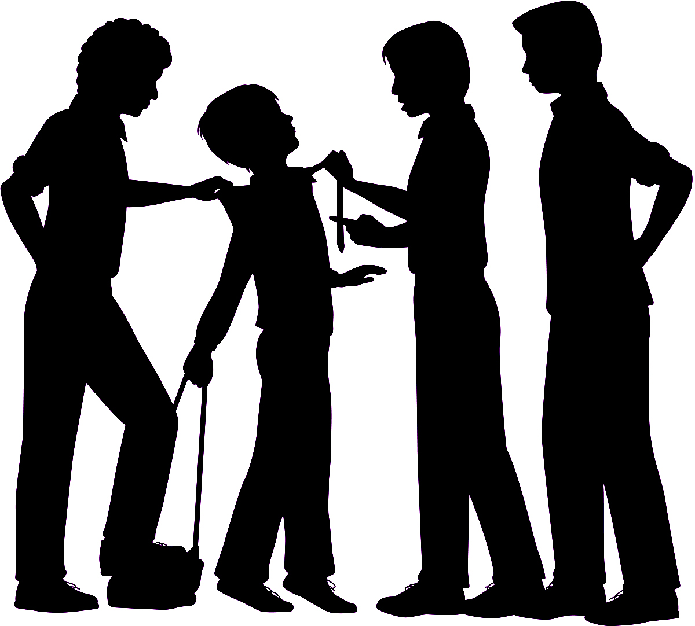
How do we can find that children is bullyed?
1. Their′s results are worse
2. They begine shy
3. Child is depressed, neurotic or begin with self-damage

Slide 7
What can you do when you are bullyed?
If speaking up seems too hard or not safe, walk away and stay away. Don’t fight back. Find an adult to stop the bullying on the spot.
Talk to an adult you trust. Don’t keep your feelings inside. Telling someone can help you feel less alone.
Stay away from places where bullying happens.
Stay near adults and other kids. Most bullying happens when adults aren’t around.

Slide 8
How to protect others from bullying?
Look at the bullying them and tell him or her to stop in a calm, clear voice. Or make a joke about it.
You can talk to some adults you trust and tell them about it.
Be kind to the kid being bullied. Stay with this child to feel your sympathy.
Find out more about where and when bullying happens at your school. Think about what could help. Then, share your ideas.
Not saying anything could make it worse for everyone.

Slide 9
https://www.fosi.org/good-digital-parenting/bullying-2019-what-it-looks-and-how-you-can-help-those-struggling/
https://www.stopbullying.gov/what-is-bullying/index.html
https://www.edutopia.org/article/empowering-students-curb-bullying
https://kidshealth.org/en/teens/bullies.html
https://www.rifemagazine.co.uk/2017/12/do-young-people-care-about-religion/
https://www.stopbullying.gov/kids/what-you-can-do/index.html
https://www.psychologytoday.com/sg/articles/201801/how-deep-is-the-impact-bullying
https://ideas.ted.com/9-pieces-of-practical-advice-about-bullying/

Slide 10
Thank you for your attention

