Slide 1
BULLYING AND CYBERBULLYING
Marek Šín and Richard Petro

Slide 2
What is bullying ?
Bullying is repeated aggressive behaviour that can be physical, verbal, or relational, in-person or online.
Bullies are often relentless, bullying over and over again for long periods of time.
You may live in constant fear of where and when the bully will strike next, what they’ll do, and how far they’ll go.

Slide 3
Physical bullying – includes hitting, kicking, or pushing you (or even just threatening to do so), as well as stealing, hiding, or ruining your things, and hazing, harassment, or humiliation.
Verbal bullying – includes name-calling, teasing, taunting, insulting, or otherwise verbally abusing you.
Relationship bullying – includes refusing to talk to you, excluding you from groups or activities, spreading lies or rumors about you, making you do things you don’t want to do.

Slide 4
The effects of bullying and cyberbullying
Whether you’re being targeted by bullies or cyberbullies, the results are similar:
You’re made to feel hurt, angry, affraid, helpless, hopeless, isolated, ashamed, and even guilty that the bullying is somehow your fault. You may even feel suicidal.
Your physical health is likely to suffer, and you are at a greater risk of developing mental health problems such as depression, low self-esteem and anxiety

Slide 5
In many cases, cyberbullying can be even more painful than face-to-face bullying because:
Cyberbullying can happen anywhere, at any time. You may experience it even in places where you’d normally feel safe, such as your home, and at times when you’d least expect it, like during the weekend in the company of your family. It can seem like there’s no escape from the taunting and humiliation.

Slide 6
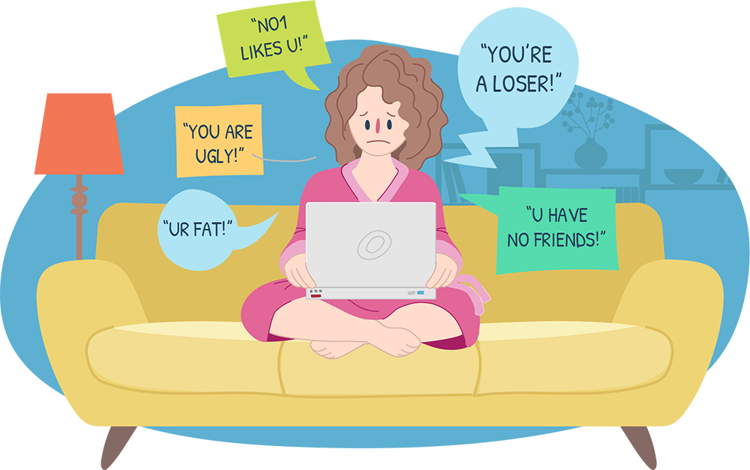
A lot of cyberbullying can be done anonymously, so you may not be sure who is targeting you
This can make you feel even more threatened...
Cyberbullying can be witnessed by potentially thousands of people
The more far-reaching the bullying, the more humiliating it can become

Slide 7
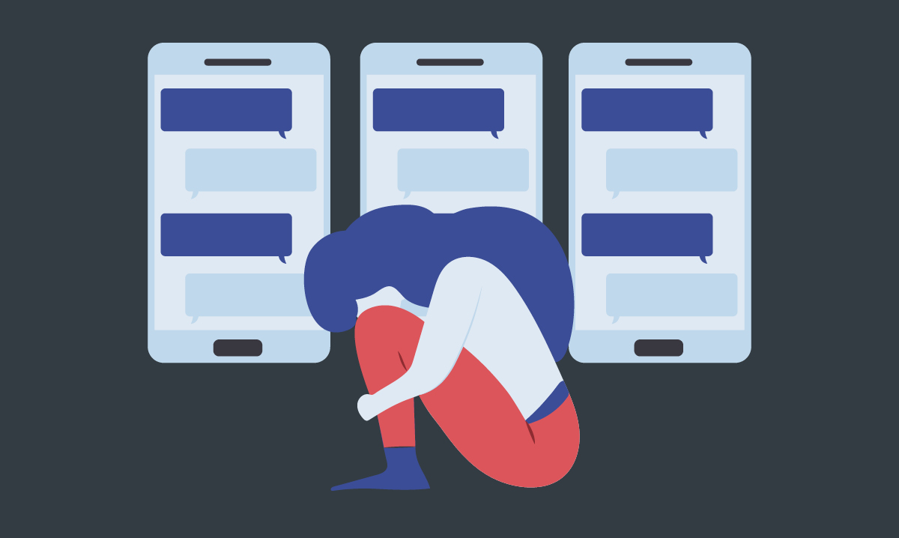
Tips for dealing with cyberbullying
Dealing with cyberbullying is rarely easy, but there are steps you can take to cope with the problem
To start, it may be a good time to reassess your technology use
Spending less time on social media or checking texts and emails, for example, and more time interacting with real people, can help you distance yourself from online bullies
It can also help to reduce anxiety, depression, and feelings of loneliness

Slide 8
As well as seeking support, managing stress, and spending time with people and activities that bring you pleasure, the following tips can help:
Don’t respond to any messages or posts written about you...
Don’t seek revenge on a cyberbully...
Save the evidence of the cyberbullying...
Report threats of harm and inappropriate sexual messages to the police...
Prevent communication from the cyberbully, by blocking their email address, cell phone number, and deleting them from social media contacts...

Slide 9
Your friend may be the victim of bullying if he or she:
Withdraws from family, friends, and activities they previously enjoyed.
Suffers an unexplained drop in grades.
Refuses to go to school or to specific classes, or avoids group activities.
Shows changes in mood, behavior, sleep, appetite, or shows signs of depression or anxiety.
Avoids discussions or is secretive about cell phone or computer activities.
Becomes sad, angry, or distressed during or after being online.
Appears anxious when viewing a text, email, or social media post.

Slide 10
resources
https://www.helpguide.org
https://www.wikipedia.org

Slide 11
Thank you for your attention

